Slide 1
You CAN Teach Quadratics with Visual Models and Engaging Activities
COABE 2015 Conference
Lynda Ginsburg and Patricia Helmuth

Slide 2
Agenda
Why Quadratics?
Factoring Quadratics
Real-life Problem Solving with Quadratics
Visual Patterns with Quadratic Relationship
Notes:
This presentation is not the answer to quadratics. We won’t be exploring quadratic graphing, even though we would have like to, there isn’t enough time. But you will walk away with some resources and ideas that make quadratics accessible to a wide level of students, and for those students you have that are at a higher level, you can bridge the activities that we will work through today to graphing.

Slide 3
Factor a quadratic expression to reveal the zeros of the function it defines.* (A.SSE.3a) [Also see 7.EE.2]
Create equations and inequalities in one variable and use them to solve problems. Include equations arising from linear and quadratic functions, and simple rational and exponential functions.* (A.CED.1) [Also see 7.EE.4, 7.EE.4a, and 7.EE.4b]
Solve quadratic equations in one variable. (A.REI.4)
CCR Standards - Quadratics

Slide 4
Create quadratic equations and linear expressions, equations, and inequalities with written descriptions you have been given.
Solve quadratic equations in one variable.
Compare two different proportional relationships OR two linear or quadratic functions when each is represented in different ways.
Evaluate linear and quadratic functions.
http://www.gedtestingservice.com/uploads/files/62153313239a5146bd1f9390c44901cb.pdf
GED Test

Slide 5
Algebra: Arithmetic with Polynomials and Rational Expressions
Algebra: Reasoning with Equations and Inequalities
Algebra: Creating Equations
Algebra: Seeing Structure in Expressions
Functions: Interpreting Functions
Functions: Linear, Quadratic, and Exponential Models
Geometry: Geometric Measurement with Dimension
Geometry: Modeling with Geometry
Number and Quantity: The Real Number System
http://www.in.gov/dwd/abe/files/TASC%20_EducatorTraining.pdf
TASC Test

Slide 6
Candidates should understand patterns, relations, and functions. Topics may include linear functions and inequalities as well as nonlinear functional relations.
Understand the concept of a function and use function notation
Build a function that models a relationship between two quantities
Construct and compare linear, quadratic, and exponential models and solve problems
Interpret expressions for functions in terms of the situation they model
http://hiset.ets.org/s/pdf/college_career_readiness.pdf
HiSet

Slide 7
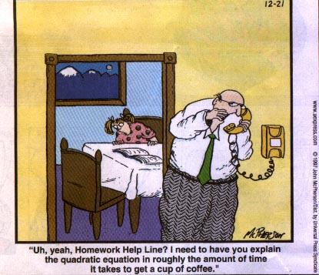
Notes:
I’m having students come to me because they’ve either heard that quadratics are on the test, or they saw quadratics on the test and they want me to teach them how to do it in 30 seconds or less. They want me to show them some rule or trick. But at the heart of the CCR is the expectation that our students will be able to tackle quadratics, or any other math situation, because they understand why procedures work. This means that they need to build understanding at lower levels of mathematics first before they can begin to understand what is happening in quadratics. Today we are going to demonstrate a few ways to help students to build that knowledge so they can understand what is happening when they are asked to factor a quadratic equation, define a pattern that has a quadratic relationship, or solve a real-life problem using a quadratic equation.

Slide 8
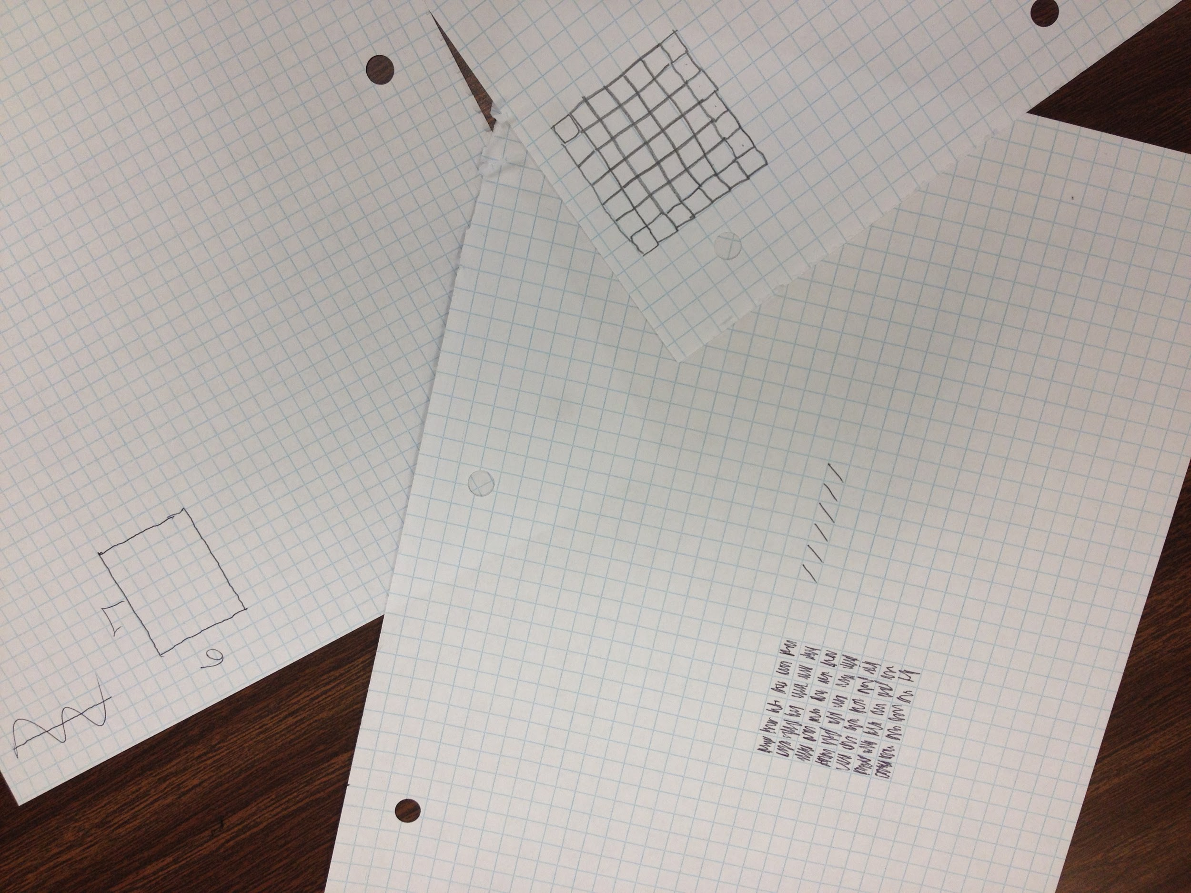
“Show me what 6 x 7 would look like on graph paper.”
Notes:
Some students may look at this and say something like, “I know 6 x 4 and 6 x 5, but I don’t know 6 x 7. When students say things like this it means that they are doing what many students (even those who know their times tables) do - they are acting under two false assumptions. (1) that math doesn’t have to make sense to you, you just have to memorize it and (12) there are no connections between all the math facts and formulas that you need to remember.
What we want is for students to have the flexibility, number sense and grasp of the purpose of mathematics to be able to do what is on the next slide.
Relate area to the operations of multiplication and addition. (3.MD.7)
Use tiling to show in a concrete case that the area of a rectangle with whole-number side lengths a and b + c is the sum of a × b and a × c. Use area models to represent the distributive property in mathematical reasoning. (3.MD.7c)

Slide 9
6(4 + 3)
4 + 3
x 6
18
24
42
4 +
3
24
18
6
The Distributive Property
Notes:
Teach our students to decompose numbers, introducing them to the distributive property early on in the learning process. We’re going to go back to this in a little bit with two digit multiplication. Before we do that, I’d like to share a student example of decomposing numbers and using the distributive property.
Use tiling to show in a concrete case that the area of a rectangle with whole-number side lengths a and b + c is the sum of a × b and a × c. Use area models to represent the distributive property in mathematical reasoning. (3.MD.7c) Talk about Anthony “I see it. I got this!”
The same can be said of multiplying a two digit number by a two digit number because this is where students really start to lose their conceptual understanding of place value. Model 15 x 13

Slide 10
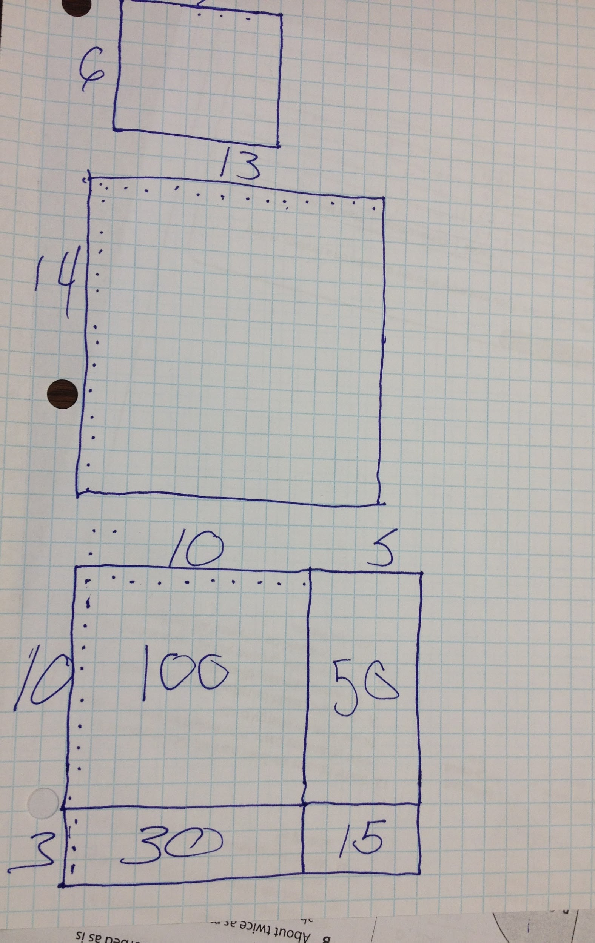
Decomposing and Distributing
Notes:
Here students start to understand place value.

Slide 11
(10 + 3)(10 +4)
10 + 3
10 + 4
x 10 + 3
10
100
30
12
30
40
100
182
+
4
40
12
Understanding vs. FOIL
Notes:
Multiply a whole number of up to four digits by a one-digit whole number, and multiply two two-digit numbers, using strategies based on place value and the properties of operations. Illustrate and explain the calculation by using equations, rectangular arrays, and/or area models. (4.NBT.5) Sometimes we lose sight of what is in the CCR because we’re so focused on what’s on the test, but the content standards give us some tips on how to build conceptual understanding that then bridges to higher level mathematics.

Slide 12
(x + 3)(x +4)
Add the areas:
x + 3
x · x + 3x + 4x + 12
x
x · x
3x
Simplify:
+
4
x² + 7x + 12
4x
12
“Apply and extend
previous understandings of arithmetic to algebraic expressions”
Notes:
These instructional strategies help our students to make application of MP7 – “Look for and make use of structure”. Students are already familiar with structure: we are building on what students already know. Shift - coherence. Ask Participants to briefly work through first example on worksheet.

Slide 13
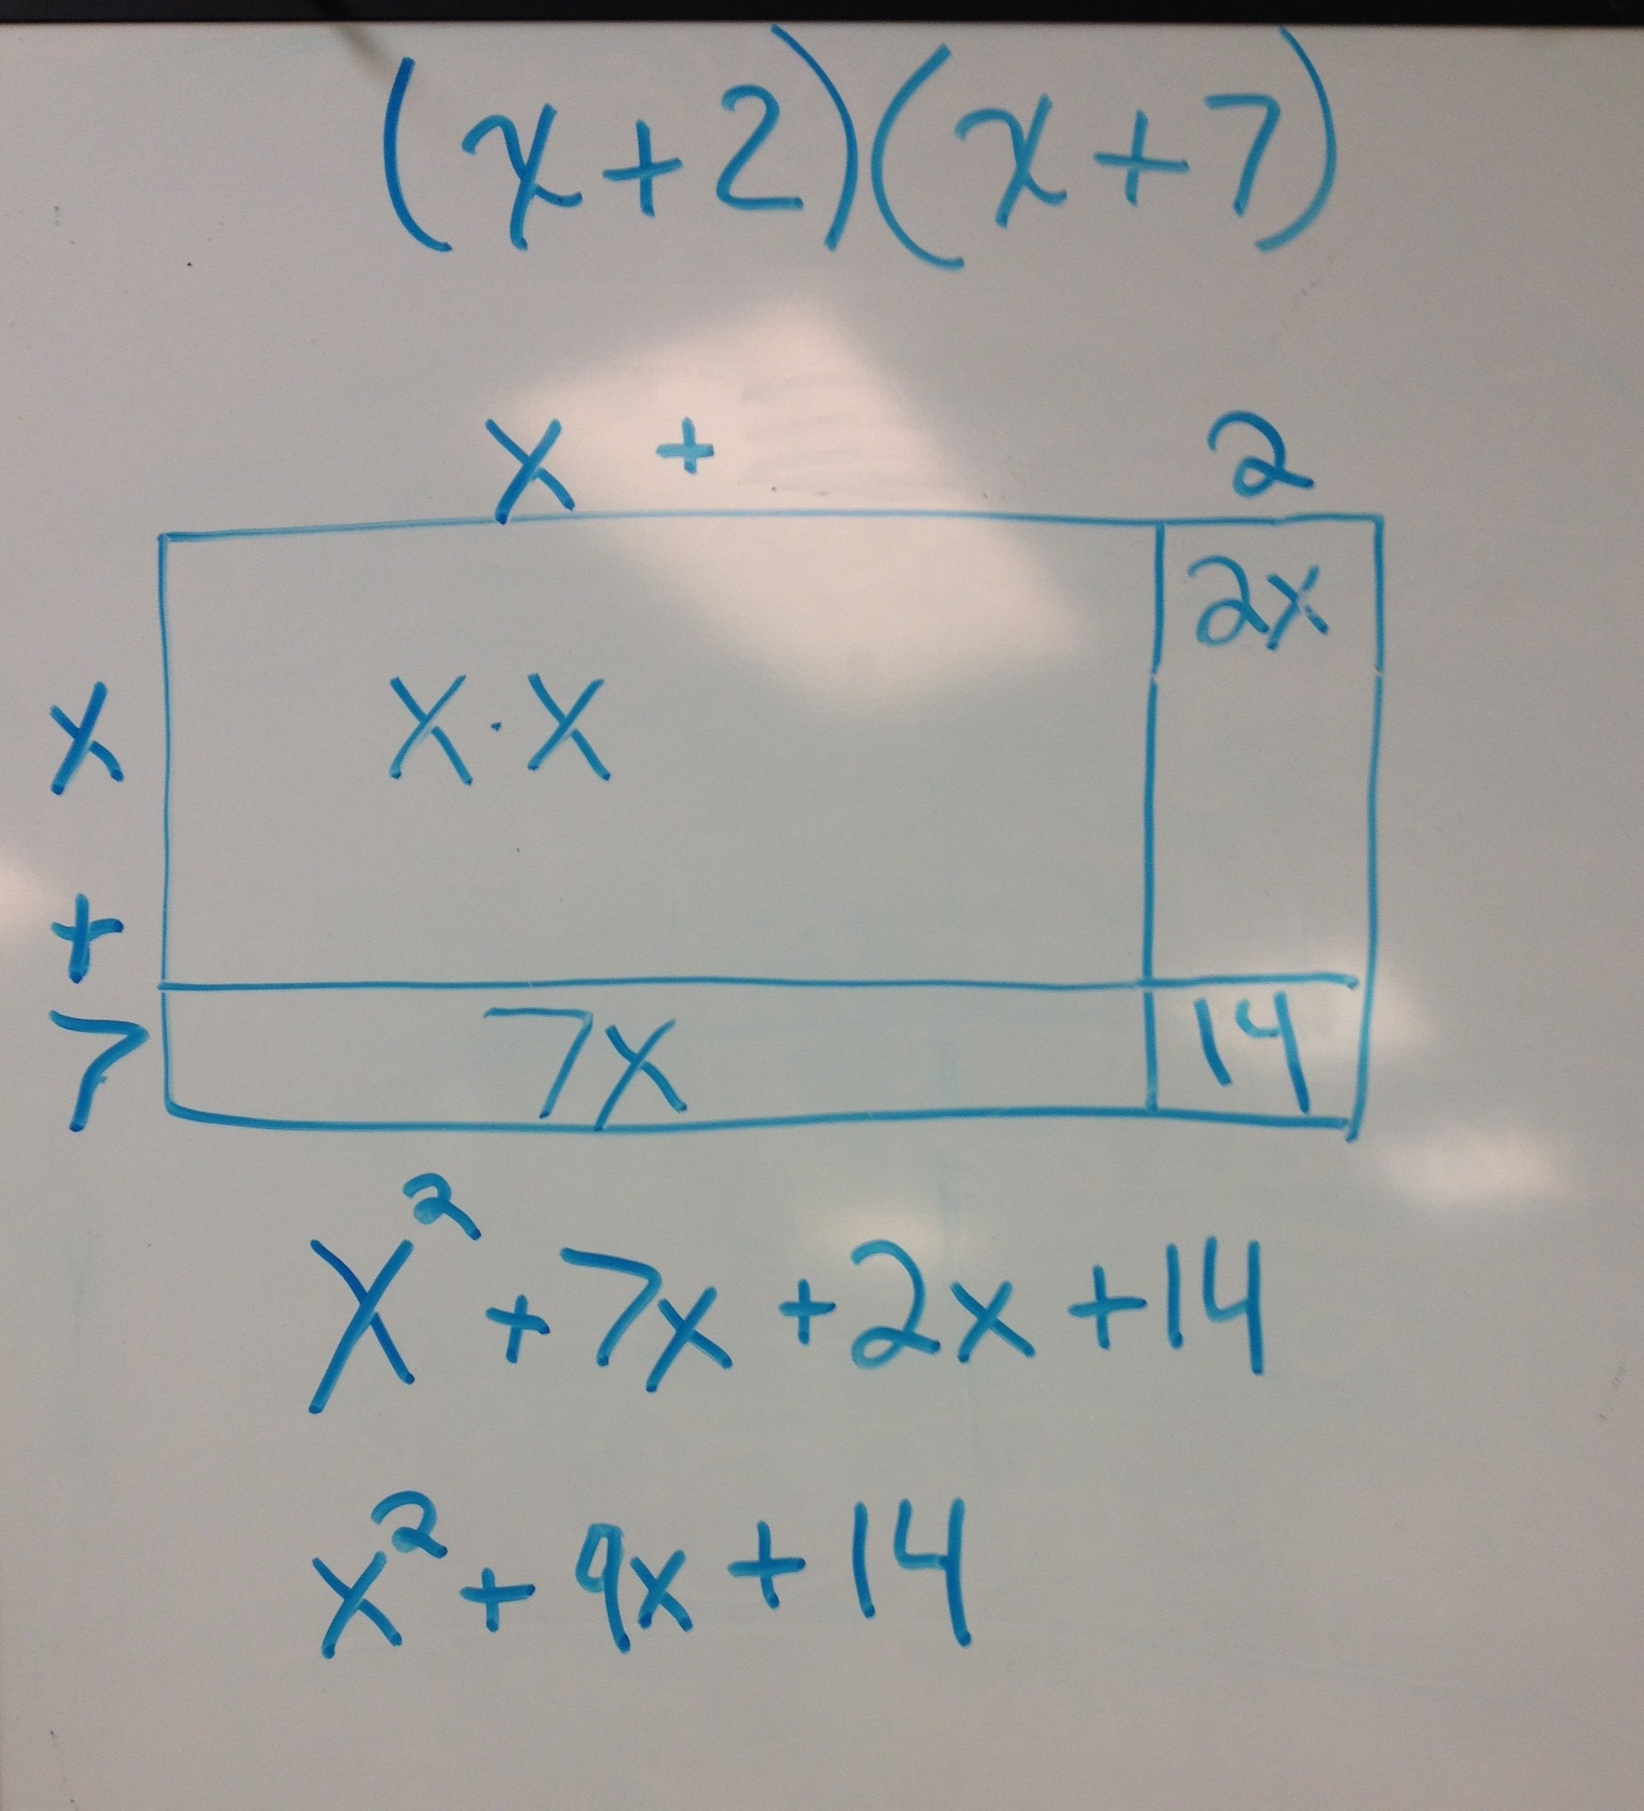
Understanding vs. FOIL

Slide 14
Use an area model to factor and solve the following Quadratic Equation: x² + 8x + 15 = 0
x + 3
(x + 3) (x + 5) = 0
Solutions: -3 and -5
x
x²
3x
+
5
5x
15
Factoring is the Reverse Process of Multiplication
Notes:
Walk through this step-by-step on chart paper asking participants: What would I do next? (Then click to show solution). Can anyone tell me what the solution set would be for this? How do you know? Can you show us?

Slide 15
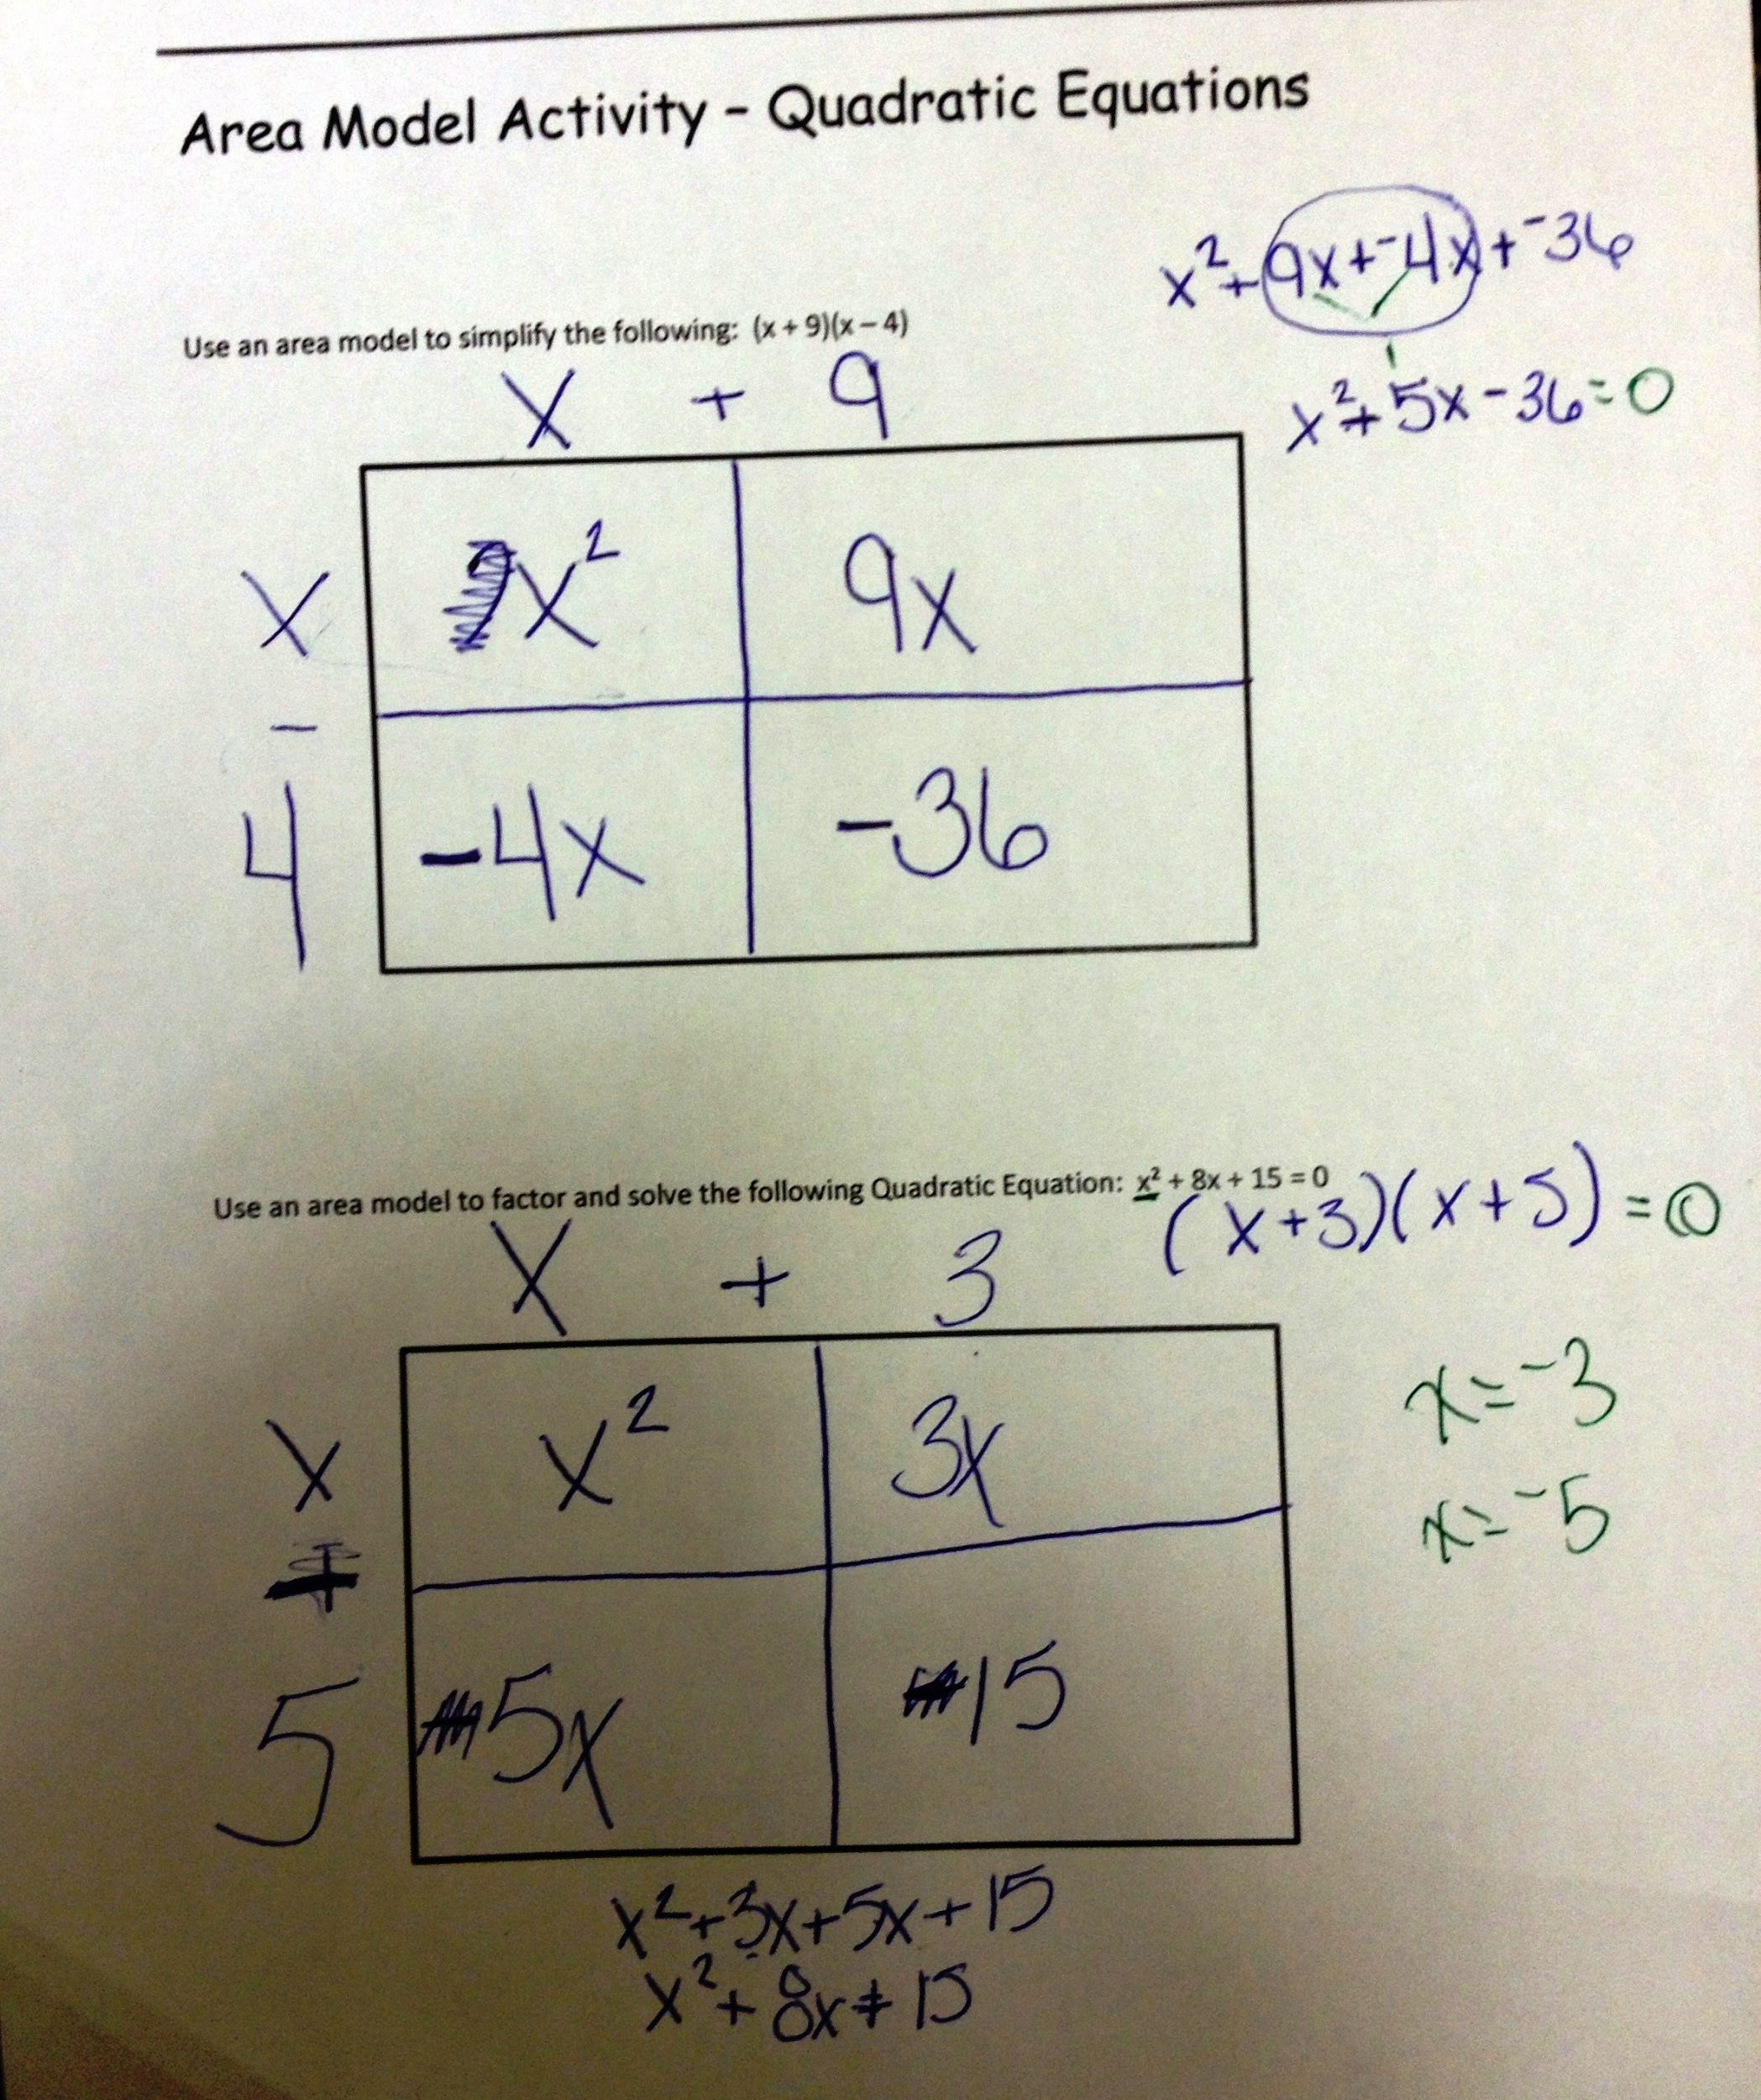
Student Example
Notes:
This is the caution I would give you: Make sure students understand how area models and the distributive property work. Talk about Cindy’s

Slide 16
There are two activities to work on:
GROUP ONE: The Wall Hanging Dilemma
GROUP TWO: Patterns
Work in pairs or groups of three.
MORE MATH ADVENTURES
Notes:
Divide room up into 2 - 4 groups. Give handouts to each group and encourage working in pairs or groups of 3 (or four??) Ask Lynda about this. As participants solve one problem, give them another problem to work on. Choose participants to share out their solution strategies. Get at least one pair from each problem: more if time permits. Show slide that accompanies the problem as participants share out. Do Wall hanging problem first. Then, talk about scaffolding with patterns.

Slide 17
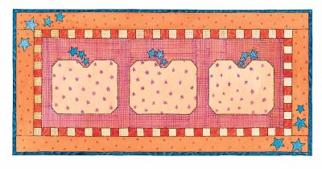
I have a 6” by 8” cloth embroidery to create a wall hanging. I want to make a border all around it. I have some material to use for the border that is 72 square inches that I will cut into strips for the border. I want to use all of my material but I don’t know how wide to cut the strips for the border. The border must be the same width on all four sides.
 | x x
x x | 8” 6” | x x
 | x x
Everyday Context
Notes:
http://www.montereyinstitute.org/courses/Algebra1/COURSE_TEXT_RESOURCE/U10_L2_T1_text_container.html
Monterey Institute Solution: Since each side of the original 6 x 8 quilt has the border of width x added, the length of the quilt with the border will be 6 + 2x, and the width will be 8 + 2x.
Area of border = (6 + 2x)(8 + 2x) – (6)(8)
Lynda’s solution: I can’t draw this – the border will be X inches all around. Dividing the border into areas, we’ll have 4 corners of x² each (=4x²) and 2 other pieces of 6x and 2 pieces of 8x. So all together, the border is 4x² + 2 (6x) + 2 (8x) = 4x² + 28x
My piece of material is 72 sq. inches so
4x² + 28x = 72
we can factor out 4 and get x² + 7x = 18
we can then factor: x² + 7x – 18 = 0 or (x+9) (x-2)
Set each factor =0 and we find that x has to be 2, so the material will be cut into 2” strips to make the border.

Slide 18
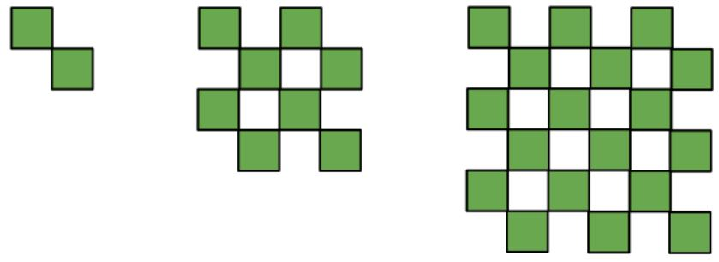
Figure 1 Figure 2 Figure 3
Visual Patterns

Slide 19
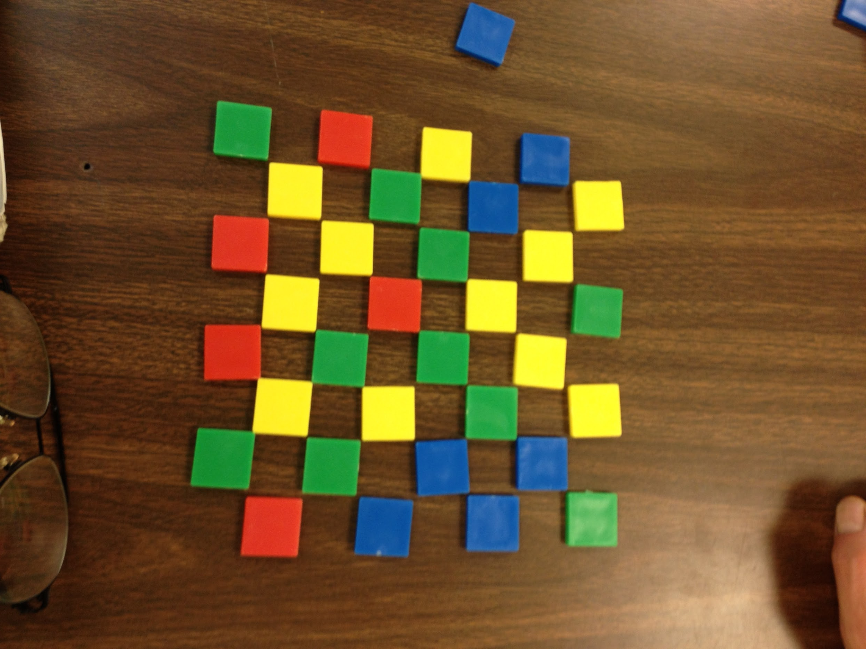
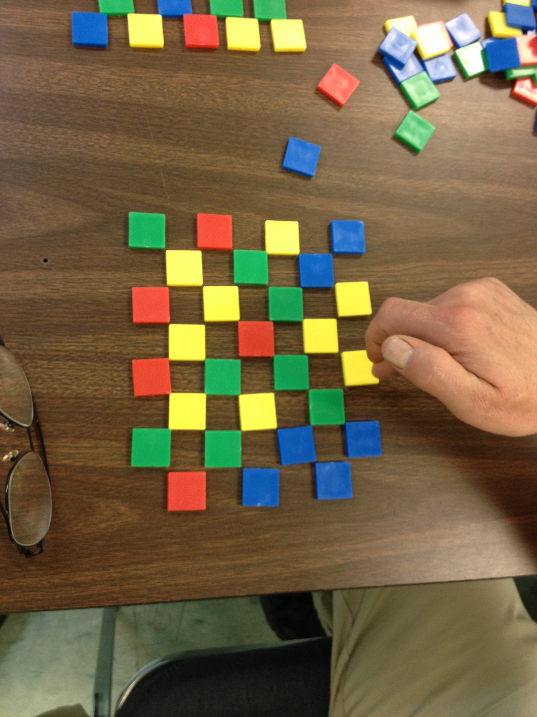
Productive Struggle

Slide 20
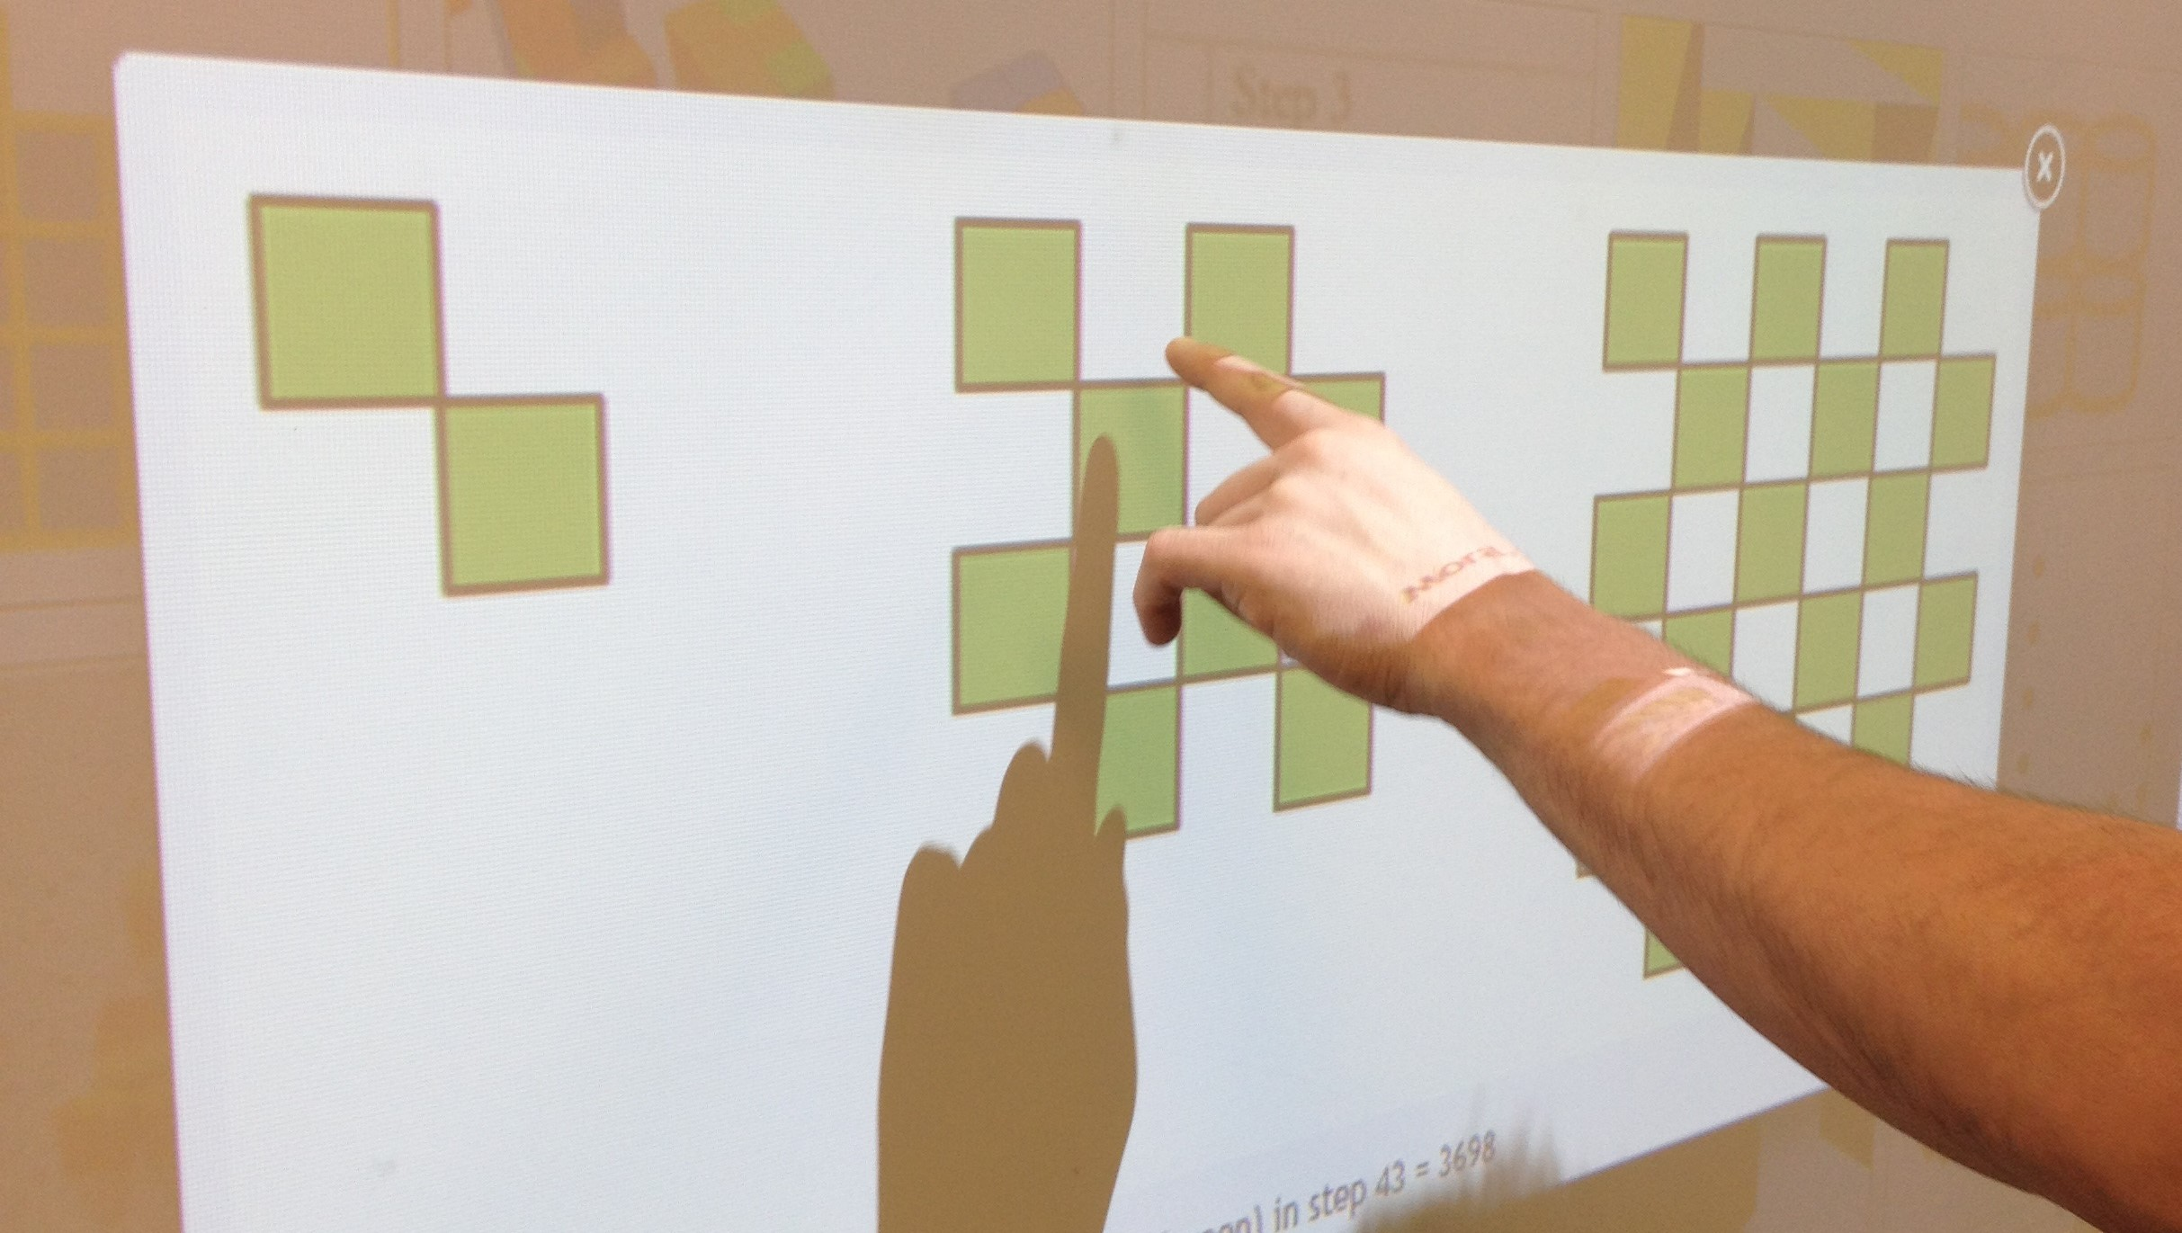
Construct Viable Arguments

Slide 21
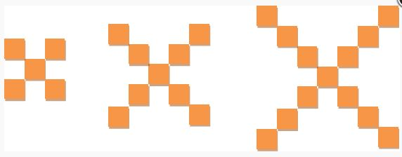
http://www.visualpatterns.org
Visual Patterns - Scaffolding - Linear Equations

Slide 22
Figure 2 Figure 3 Figure 4
Visual Patterns - Scaffolding
Notes:
Run through these next 3 slides and discuss scaffolding

Slide 23
Figure 1 Figure 2 Figure 3 Figure 4
Visual Patterns - Standard Quadratic Form

Slide 24
Conceptual Understanding of Fundamental Mathematics
Scaffolded Instruction
Hands on Learning
Visual Models
Facilitate Productive Struggle
What is my student thinking?
Meta-cognitive skills
Sharing Solution Strategies
Bridging to Quadratics
Notes:
In sum, we don’t want to think in terms of teaching Quadratics, we want to think about how we can bridge to quadratics by:

Slide 25
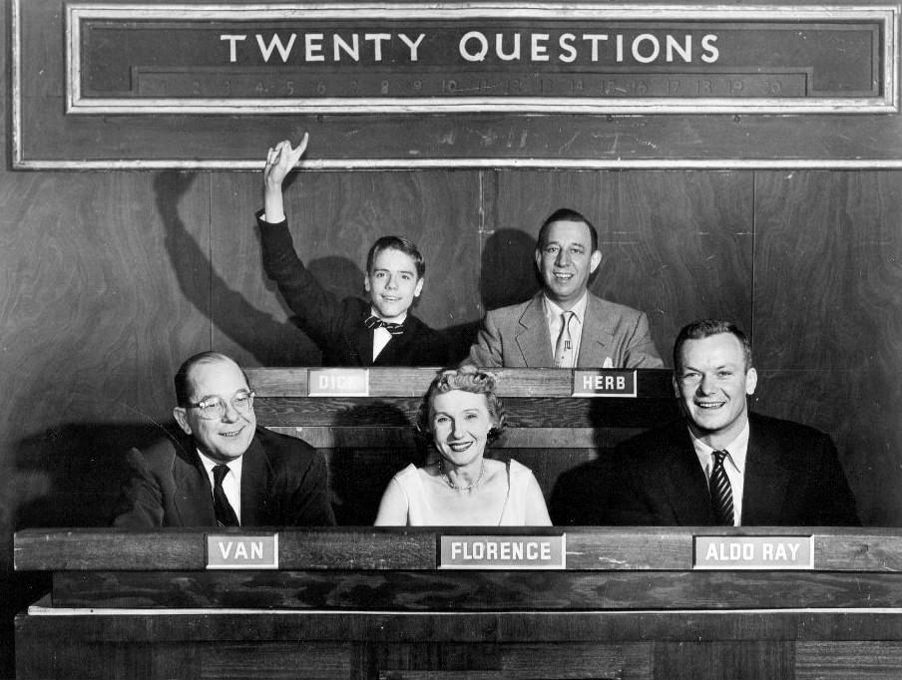
Questions
Notes:
Let participants know that presentation will be available with handouts at COABE repository. Collect email addresses from anyone who would like to be emailed directly with resources.

Slide 26
www.adultnumeracynetwork.org
www.collectedny.org
www.cunycci.pbworks.com
www.visualpatterns.org
EMPower's Seeking Patterns, Building Rules
Laws of Arithmetic
Interpreting Equations
Steps to Solving Equations
Functions and Everyday Situations
Solving Quadratic Equations: Cutting Corners
www.map.mathshell.org
Resources
Notes:
Last four resources are from http://map.mathshell.org Example of scaffolding. Grades 6-12. Start with grade 6 to build conceptual understanding.

Slide 27
Contact Information
Lynda Ginsburg
ginsburg@rci.rutgers.edu
Patricia Helmuth
patricia.helmuth@scboces.org

