Slide 1
Intentional Connections:
Providing Low Level Students with Pathways to Success

Slide 2

State Mandates
New TSIA began Fall 2013
Students Score
  College Ready
  Developmental Education with Diagnostics
  Adult Basic Education (ABE) with Diagnostics
Adult Basic Education (ABE)
  Score of 5 or 6 = Developmental Education
  Score of 4 = Institutional Decision, Financial Available (BASE)
  Score of 3 = Institutional Decision, No Financial Aide Available (BASE)
  Score of 1 or 2 = referred to ABE programs

Slide 3
Developmental Education
Developmental Education is a field of practice and research within higher education with a theoretical foundation in developmental psychology and adult learning theory. (NADE & NCDE).
Provides for cognitive and affective growth of all postsecondary learners, at all levels of the learning continuum.
It is more than a 16 week course of content.
  Learning support
  Tutoring, group tutoring
  Counseling
  Development of learning strategies
  Reducing affective barriers to learning

Slide 4

Let’s talk about -
Intentional Connections
Whose Lens
Are You
Using?

Slide 5
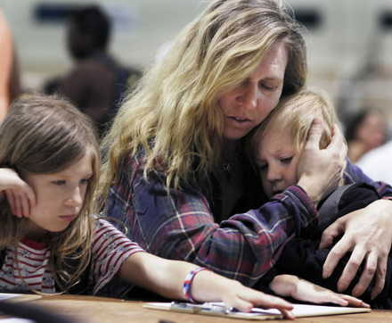
The Reality of the ABE Student
I’m Margot Brown and I’m going to start college this Fall.
I’m a single mother trying to make my life better for me & my kids.

Slide 6
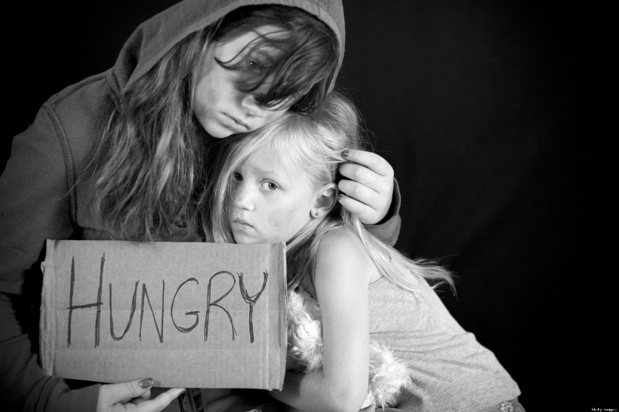
A glimpse into Margot’s world
26 years old, trying to get into the nursing program
I tested at the ABE level classes
Living in poverty, with 2 part time jobs
Single mom supporting two young children
Abusive ex-boyfriend
Often go hungry so family can eat
Car is old and breaks down all the time
Had fire in apartment 4 years ago, lost many things
Went to juvenile detention as a teen for shoplifting
Abused by father & uncles
Family history of mental illness

Slide 7
My Reality!
Factors that may contribute to me leaving school:
  College was not what I thought it would be.
  I never was good at school so why would I expect to be now?
  I have no idea what courses to take.
  Everyone at home thinks this is a “stupid” idea.
Ways to help change this:
  Relevant materials (contextualized)
  Small success steps
  Visualizing the end goal
  Opportunity for counseling, personal attention, flexible scheduling
  *Kerka, S. 1995

Slide 8
Our Truth at SJC
Lowest level developmental students historically stand little chances of completing a credential or being retained
Lowest level reading/writing (9 Contact Hours)
  Only stand alones, INRW 0301 and 0302 for other students
ABE Level 3 and 4, as determined by TSIA, yet have a high school credential
Students need intentional guides to successful completion
Help in establishing GRIT

Slide 9
Who Are the Students We Serve
Students with disabilities including learning disabled, physical disabilities, and visual impairments
Single parents with children
Recent high school graduates
Non-traditional older students returning to school
Second language learners

Slide 10
Examples of Life Issues
Students Face
Abuse
Pregnancy
Abortion
Murder
Suicide
Drugs
Eviction
Money
Financial Aid
Parents
Self esteem
Divorce
Depression
Incarceration
Lack of student skills
Poor Preparation
Disabilities
ESL
Psychological problems

Slide 11
First Year of Testing
 | MATH | READ | WRITING
ABE | 2,901 | 2,232 | 2,212
DEVELOPMENTAL EDUCATION | 2,479 | 1,711 | 2,407
COLLEGE READY | 1,795 | 3,153 | 1,318

Slide 12
ABE Levels
ABE Levels | MATH | READ | WRITING
6 | 3 | 525 | 863
5 | 850 | 1,019 | 433
4 | 704 | 295 | 615
3 | 164 | 39 | 169
2 | 29 | 52 | 43
1 | 2 | 15 | 37

Slide 13
Theoretical Structure of IC
Provide intensive mentoring and support in a learning community (LC)
  LC improve students learning experience
  Improved learning outcomes
  Quicker pathway through English requirements(MDRC)
Provide deliberate pathways for students
Connect students to college program and workforce
Instruction in needed basic skills
Guide students in developing definite educational and career plans
Assist students in realizing they do belong in further educational experiences

Slide 14
Program
First semester students placed in Learning Community consisting of 3 classes:
  Student Success Class: 3 credit hrs. with faculty advisor
  Read 0308: 3 credit hrs./2hrs. weekly lab
  English 0306: 3 credit hrs. /1hr. weekly lab
Recommended: Math not taken until second semester
Student Success or Reading Instructor serves as case manager

Slide 15
Program
Students complete career assessments (Focus 2) to determine career interests
Case Manager schedules meetings with program directors or chairs in their chosen career areas
Provide students opportunity to visit class in area of career choice
  Opportunity to try out the classes
  Decide they if wish to pursue career in that area

Slide 16
Options for Students
For those entering not college ready, how can we improve their
retention and completion rates?
STEP 1: Know Your Students
STEP 2: Conduct Institutional Needs Analysis –
• Identify all programs and services for students
• Academic fields of study (FOS)
• CTE programs of study (POS) (level 1, 2 certificates)
• CE technical certificates (articulated)
• Accelerate TX and Career Pathways
• Adult Education and Literacy (including ESL and GED)
• Community programs and services
• Identify gaps in programs/services for YOUR students
Notes:
Source: http://www.thecb.state.tx.us/reports/PDF/7187.PDF?CFID=36478209&CFTOKEN=71863495

Slide 17
Options for Students Continued
STEP 3: Understand Funding Options
Federal financial aid (e.g., Pell)
State formula funding
Grants (e.g., ATX, AEL, TPEG)
Needs‐based funding (e.g., Pell, Trio, DARS, SNAP, TANF)
STEP 4: Strengthen Advising
Identify and train advising specialists for underprepared students
Ensure specialists understand all options and funding opportunities/limitations
Build intake protocols that identify student career goals EARLY, informed by regional labor market and wage information
Provide recommendations based on student goals and life circumstances
Ensure short term completions (i.e., Level 1 Cert.) are stackable to more robust credentials
Notes:
Source: http://www.thecb.state.tx.us/reports/PDF/7187.PDF?CFID=36478209&CFTOKEN=71863495

Slide 18
Options for Students Continued
STEP 5: Rethink interventions for underprepared students
Contextualize basic skills support
Focus on students’ knowledge and skill gaps
Reduce exit points to one stand‐alone intervention; everything after that is co‐requisite (mainstreamed)
Intensify: more weekly contact hours for shorter time periods
Continuing and Career/Technical Education
Level 1 Certificate students can be tested for diagnostic purposes to identify and provide co‐enrollment interventions to address gaps
May require additional support for students not passing
Notes:
Source: http://www.thecb.state.tx.us/reports/PDF/7187.PDF?CFID=36478209&CFTOKEN=71863495

Slide 19
Enrollment
Fall 2011 - Fall 2015
TERM | Enrolled | Success (A-C)
 |  | Number | %
Fall 2011 | 20 | 15 | 75%
Fall 2012 | 11 | 6 | 55%
Fall 2013 | 88 | 68 | 78%
Spring 2014 | 222 | 157 | 71%
Fall 2014 | 405 | 299 | 74%
Spring 2015 | 213 | 144 | 68%
Fall 2015 | 585 | 433 | 74%

Slide 20

Directions:
Problem Solving Activity
Assume the role of one of the students described on the next slide.
Then complete the Problem Solving Tool. (Please refer to the handout.)
Be prepared to share your solution with the group.

Slide 21
Scenarios
Student number 1: John Smith is a 19 year old student who lives at home and with his mother and 3 younger school age siblings. John works 35 hours a week to help his mother support the family. His mother is a single parent and receives no child support. John drives a 2000 Honda Civic that frequently breaks down.

Slide 22
Scenarios Continued
Student number 2: Jane Doe is a 31 year old mother of three young children who has recently decided to return to school. Her husband works at a chemical plant. All three children attend the neighborhood school. Jane works part time as well. Her car is ten years old.

Slide 23
Scenarios Continued
Student number 3: Renee Reynolds is a 23 year old single parent with two children , one of who has a chronic disease which may require periodical hospitalization. Renee works 40 hours a week and depends on an elderly grandmother for child care. She drive a 17 year old car and lives near a bus line.

Slide 24
The Need to Change Student Thinking and Mindset
Many student fail to think of alternatives
  Giving up is often the choice
Our focus is to teach students to problem solve
Look at multiple solutions
Choose the alternative that best fits their situation
Goal is to develop a solution that will enable success

Slide 25
Need to Build a Culture of Success
Many students know nothing but failure and disappointment
Others lack experiences because of lack of opportunity
Poor self-esteem also a major factor
  e.g. “I have always been a failure in life.”
Need to change student thinking from a “fixed mindset” to a “growth mindset.” (Dweck)
  Develop “grit” needed to overcome adversity

Slide 26
Develop Grit (Duckworth)
https://www.ted.com/talks/angela_lee_duckworth_the_key_to_success_grit?language=en

Slide 27
How to Help Students Build a Culture of Success
Hold students accountable for their actions and decisions
Emphasize solving problems instead of “admiring the problem”
Make opportunities available to students when possible they might not have had in the past

Slide 28
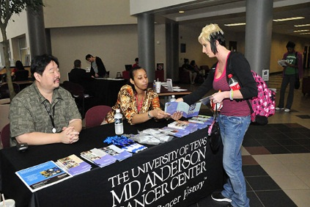
Example of Opportunities: Career Fair
Provides students with information needed to make more informed decisions about possible career pathways
Connects students to the programs and departments

Slide 29
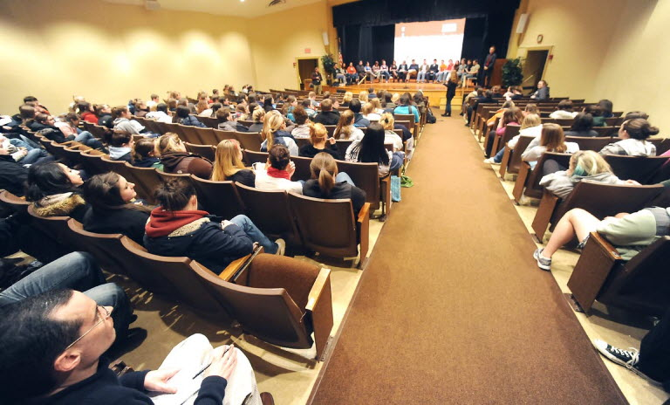
Example of Opportunities:
Informal Gatherings
North Campus – First Contact Meeting

Slide 30
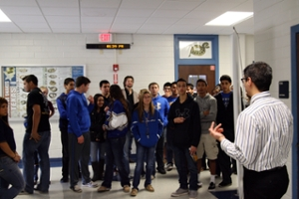
Example of Opportunities:
Field Trips
Students visit MD Anderson in Houston, TX

Slide 31
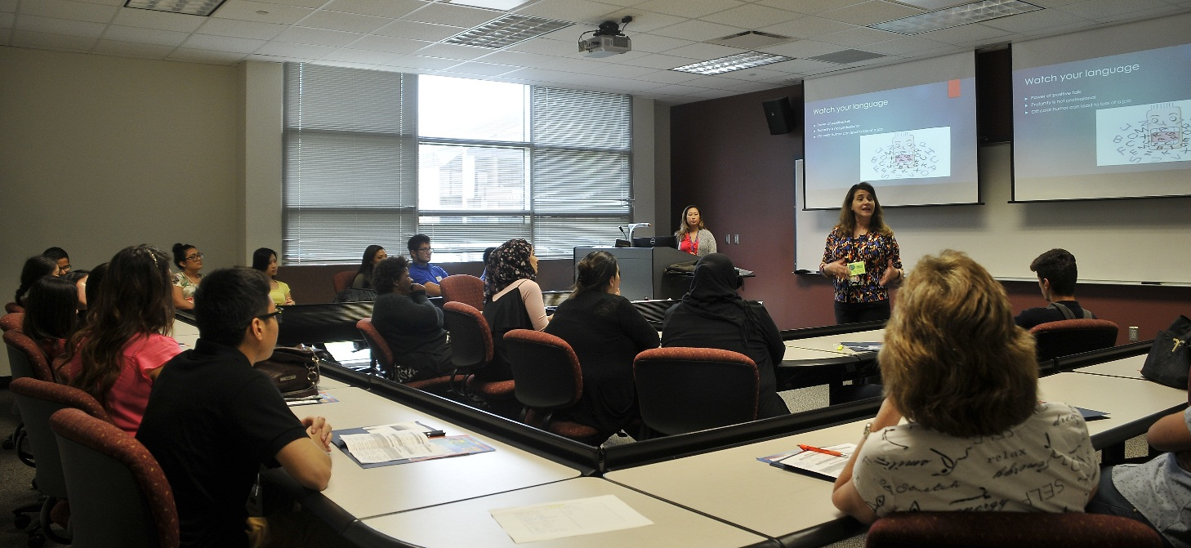
Example of Opportunities: Student Conference on Soft Skills
Afforded students opportunity to experience a professional conference
Included key note speaker as well as break out sessions
Featured a fair with local employers and college departments

Slide 32
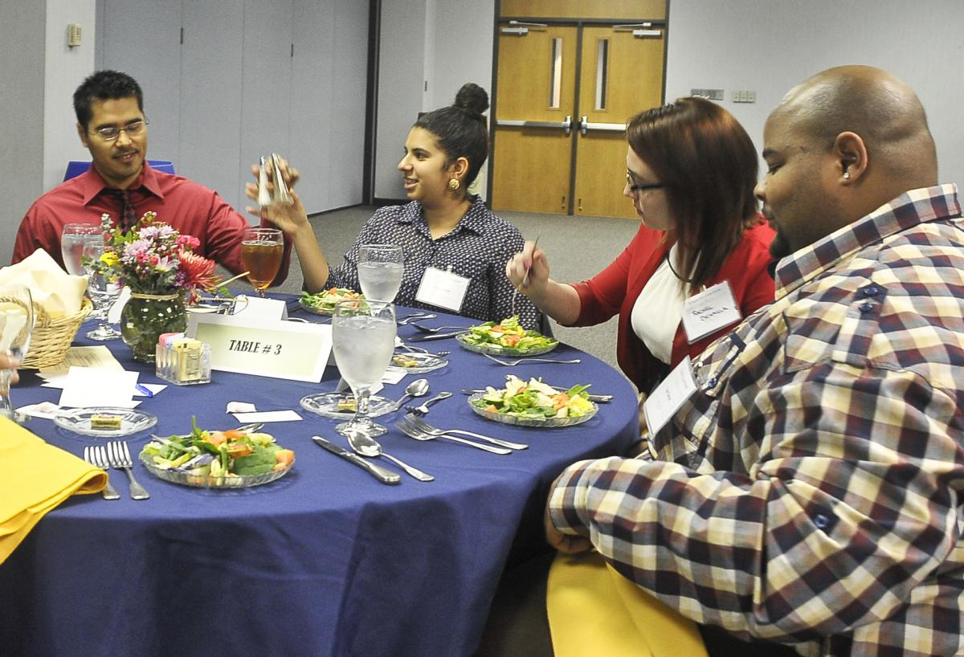
Example of Opportunities Business Etiquette Luncheon

Slide 33

Example of Opportunities: Speed Networking Event

Slide 34
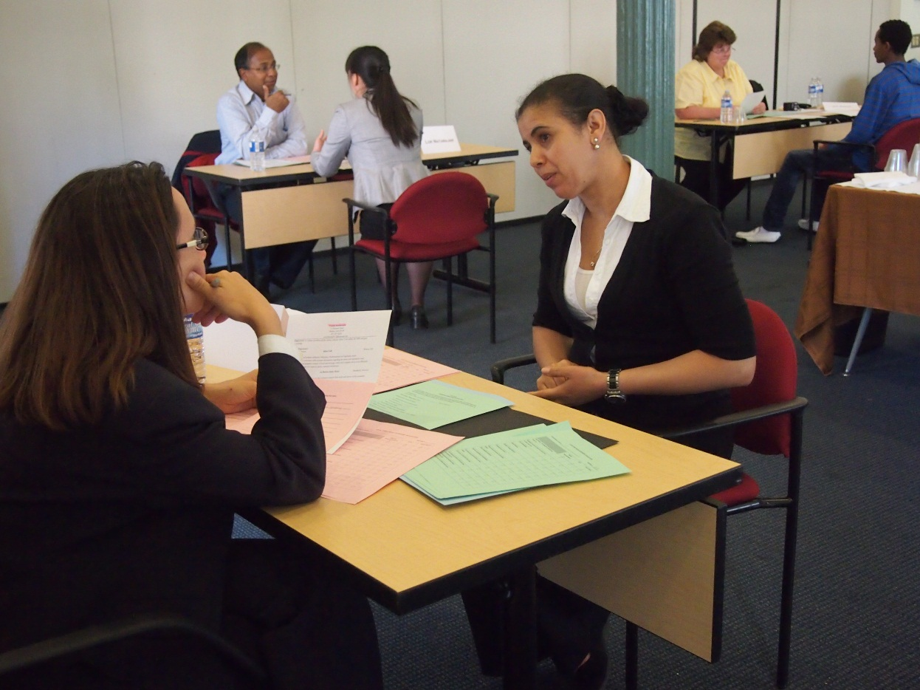
Example of Opportunities:
Mock Interviews

Slide 35

Opportunity Center: iConnect
ESL/ ESOL
General Students
CPD
Student Success Center
Student Services
Student Life
Enrollment Services
CPD
Business Office
Financial Aid
Testing Center
1st Yr Experience
Veteran’s Center
Student Ambassadors
Degree Checks

Slide 36
Developing Your Own Program
Use the program planning sheet found in your handout packet to develop your own program or make adaptations to an existing one.
Be prepared to share your ideas with others.

Slide 37
Bottom Line
* FUNDING SOURCES SHOULD NOT LIMIT STUDENTS’ OPTIONS *
EXPECTATION:
Institutions should consider all options when serving students to and through successful certificate and degree completions
CHALLENGE:
Your challenge is to bring everyone to the table to FIGURE OUT HOW to make this happen. You are not alone; learn from other colleges. Be proactive.
BENEFITS:
MEASUREABLY IMPROVED OUTCOMES IN STUDENTS’ PERSISTENCE AND COMPLETIONS
Notes:
Source: http://www.thecb.state.tx.us/reports/PDF/7187.PDF?CFID=36478209&CFTOKEN=71863495

Slide 38

Questions and Answers

Slide 39
Further information:
Program Coordinators:
Amy Axtell (Central Campus) amy.axtell@sjcd.edu
Myrna Valdez (North Campus) myrna.valdez@sjcd.edu
Robert Sandhaas (South Campus) robert.sandhaas@sjcd.edu
Thank You!

