Slide 1
Facilitating Group Instruction in the Adult Learner Classroom
Angela Piña, M.Ed.
COABE Conference
Dallas, TX.
April 10- 13, 2016

Slide 2
WHO AM I?
Angela Pina
ABE/HSE Coordinator
Teaching experience
Family
Small Secret

Slide 3
Who Are YOU?
Name
Job Title
Family
Small Secret

Slide 4
Think Pair Share
Think about the title of this workshop: Facilitating Group Instruction in the Adult Learner Classroom
Talk about ways you already facilitate group instruction
You will have an opportunity to share in a bit.

Slide 5
SHARE
Choose a representative who will discuss one way to facilitate instruction.
If someone else says yours, you have to come up with a different one.

Slide 6
Agenda- Bigger and Better:
Designed for Completion
Differentiating Instruction
Cooperative Learning
Creating Meaningful Connections
Improving student engagement
AVID Strategies
Flipped Classroom
Project- Based Learning
Foldables
Creating a notebook
Team teaching
Technology

Slide 7
Students who attend class regularly, and who actively participate in group discussions are more likely to complete the program.

Slide 9
PREMISE OF D4C
You cannot create a significant change in student behavior unless and until you create a significant change in the behavior of staff and faculty that leads to and sustains better and better student interest in coming to school, staying in class, and graduating.

Slide 10
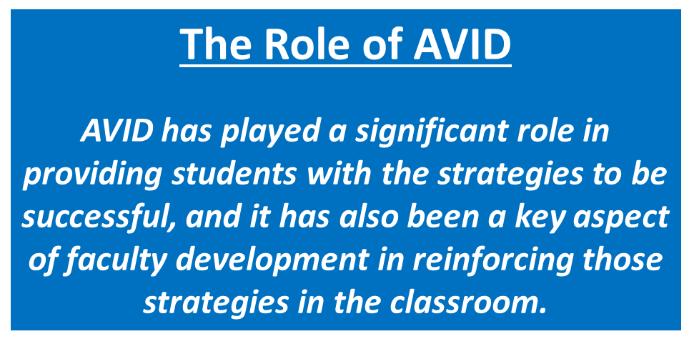
Odessa College is proud to be the FIRST National Demonstration Site for Higher Education, (AHE).

Slide 11
Drop Rate Improvement Program
Interacting with the students by name by the first class/ end of the first week
Close monitoring of student behavior and progress with immediate intervention
One on one meetings/frequent communication with students early in semester.
“Masters of Paradox”: Highly structured courses with penalties for missed assignments/ classes, but flexible when appropriate.
Four
Instructor Commitments

Slide 12
Drop Rate Improvement Program
Four Student Commitments
Complete what you start
Ask questions and use support resources
Attend class and attempt each assignment
Develop well-organized and disciplined work habits

Slide 13
March, 2016
For the first time ever, we have students enrolled in BOTH GED classes, AND college classes.
The expectation is that students will receive a GED and a Level 1 Certificate within one year.
Level 1 certificate choices:
Child Development
Word Processing
Medical Office
Industrial Tech

Slide 15
Differentiating Instruction
Differentiation consists of the efforts of teachers to respond to an individual or small group to vary his or her teaching in order to create the best learning experience possible.
Four classroom elements based on student readiness:
Content – what the student needs to learn or how the student will get access to the information;
Process – activities in which the student engages in order to make sense of or master the content;
Products – culminating projects that ask the student to rehearse, apply, and extend what he or she has learned in a unit; and
Learning environment – the way the classroom works and feels.

Slide 16
Content
Examples of differentiating content include the following:
Using reading materials at varying readability levels;
Using spelling or vocabulary lists at readiness levels of students;
Presenting ideas through both auditory and visual means; and
Meeting with small groups to re-teach an idea or skill for struggling learners, or to extend the thinking or skills of advanced learners.
Differentiating Instruction, Cont.

Slide 17
Process
Examples of differentiating process include the following:
Using tiered activities that proceed with different levels of support, challenge, or complexity;
Providing interest centers that encourage students to explore subsets of the class topic of particular interest to them;
Developing personal agendas (task lists written by the teacher and containing both in-common work for the whole class and work that addresses individual needs of learners);
Offering manipulatives or other hands-on supports for students who need them; and
Varying the length of time a student may take to complete a task in order to provide additional support for a struggling learner or to encourage an advanced learner to pursue a topic in greater depth.
Differentiating Instruction, Cont.

Slide 18
Products
Examples include the following:
Giving students options of how to express required learning (e.g., create a puppet show, write a letter, or develop a mural with labels);
Using rubrics that match and extend students' varied skills levels;
Allowing students to work alone or in small groups on their products; and
Encouraging students to create their own product assignments as long as the assignments contain required elements.
Differentiating Instruction, Cont.

Slide 19
Learning Environment
Examples of differentiating learning environment include:
Making sure there are places in the room to work quietly and without distraction, as well as places that invite student collaboration;
Providing materials that reflect a variety of cultures and home settings;
Setting out clear guidelines for independent work that matches individual needs;
Developing routines that allow students to get help when teachers are busy with other students and cannot help them immediately; and
Helping students understand that some learners need to move around to learn, while others do better sitting quietly.
Differentiating Instruction, Cont.

Slide 20
Here is a rare find:
Our instructors do not use a lot of “handouts”. However, there are a few times that we find something that students can utilize, so we make a copy and have them put it in their notebooks.
Because we do not have a lot of handouts, students know what we give them is important.

Slide 21
Cooperative vs. Collaborative Learning
Collaborative learning is less formal, and less structured.
Cooperative learning is more deliberate. It is usually structured by the teacher.
Learner Contract
Instructions
Individual Accountability
Face to face interaction
Most students already work collaboratively with each other, either because they ask what they missed, or they ask each other for assistance.
Most adults already solve many real-world problems as a member of a team.
They work at jobs where they have to work with others, or
They ask others for input before making a major decision.

Slide 22
Cooperative Learning
Social Contract:
When students are going to work together to create a project, they need to agree upon certain rules.
It is better to allow them to make up the group name, as well as the group rules.
Instructors should always facilitate this process, providing more guidance in the beginning, but then allowing learners more freedom as the year progresses.

Slide 23
AVID Strategies Quickwrite
Having students do a daily Quickwrite will not only get their brains ready for class, it will also help them to build skills necessary to pass the writing portions of the GED test.
Quickwrite Examples:
Explain how to solve the equation: 5x[2(5+4)- 3(-7)+4]
Discuss mitosis and meiosis. Tell how they are similar and different.
Compare and Contrast an active reader vs. a passive reader.
Which Republican Candidate has the stronger platform? Support your opinion with details.

Slide 24
AVID Strategies
Cornell Notes are a note taking strategy designed to help students better understand the material being presented.

Slide 25
AVID Strategies Socratic Seminar
Dialogue vs. Debate
Reflection
Discussion
Notes
Not about right or wrong

Slide 26
Flipped Classroom
Allows more time for projects
Allows students to be more active participants in class
Students can watch/ take notes at their own pace
Students are now held accountable for their own learning
How to accommodate students who do not have access to technology
Students who have limited experience with technology

Slide 27
Project- Based Learning
Allows students to put into practice what they learn in the classroom
Students retain more information
Students develop confidence as they complete projects
Students learn how to work together to achieve a goal
Some reluctant learners will not participate
Need Social Contracts
Instructors need to have rubrics for students to follow

Slide 28
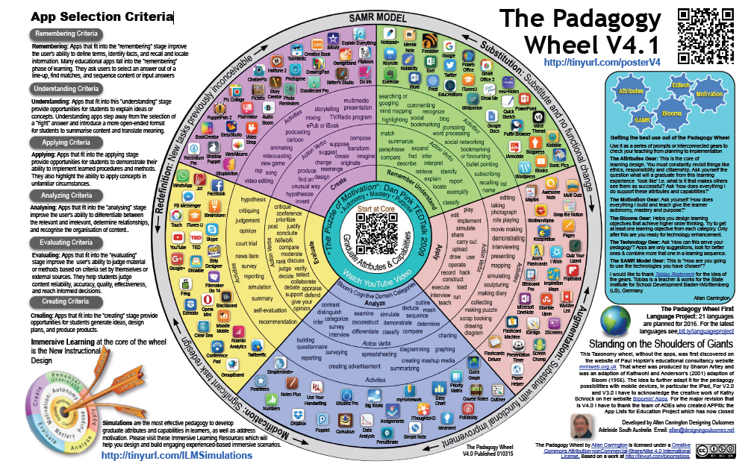
PADagogy

Slide 29
Kahoot.IT
When you set up a Kahoot account, you can play games with the students, and download the results of the game. This will give you an idea of who needs additional support.

Slide 30
3-2-1
Write;
3 things you learned
2 things you will implement at home
1 question you still have
This is a great way to assess what your students have learned, and what they still need from you.

Slide 31
Thank You Very Much!
Angela Piña, M.Ed.
ABE/HSE Coordinator
Odessa College
apina@odessa.edu
(432) 335-6385

