Slide 1
Closing the Loop: Increasing Educational Gains While Significantly Advancing Students‘ Foundational Skills
Presented by
Nicole Kelsheimer
and
Stephanie
Stewart-Reese
Rio Salado College
COABE 2016
Notes:
Introduce selves, give brief background

Slide 2
Challenges
Meeting student needs?
Feeling overwhelmed, discouraged
Meeting instructor needs?
Difficulty of differentiating
Meeting program needs?
Student retention
Challenge of capturing post-TABE
Notes:
Stephanie
Set up connection to session description
Feeling overwhelmed when put into ongoing classes
Students dropping out – also a program problem
Instructors overwhelmed by trying to meet the needs of incoming students while ensuring existing students continued to progress
Because students were all over the place with enrollment dates, the task of determining who was ready to take post-TABE was difficult.

Slide 3
Adult Education in Maricopa County
State of Arizona:
population 6.73 million (US Census Bureau)
825,000 adults lack either a high school or high school equivalency (HSE) diploma
12% of state population
Maricopa County:
population 4.17 million (US Census Bureau)
275,892 adults have 8th-grade education or less
6.6% of county population
139,729 have 9th - 12th -grade education (but lack diploma)
3.3% of county population
(Data Source from Economic Modeling Specialists, Inc. – EMSI)
Notes:
Nicole

Slide 4
Rio Salado College
Part of Maricopa County Community College District
Rio was established in 1978 as “the college without walls”
59,000 students served per year
nearly half attending adult education classes in person
3rd in nation as “Top Producers of 1-Year Certificates” (“Community College Week”)
College Bridge Pathways
Grant-funded adult education programs, including HSE, ELAA, AACE, Incarcerated Re-entry
Notes:
Nicole
Being part of a college provides both resources and challenges
Resources
Access to resources that smaller programs do not have
Name recognition
Support for moving on to post-secondary
Challenges
Program not always understood by other departments
Not all resources are available (e.g. SIS)

Slide 5
Program Snapshot
Six Locations, plus online classes
Managed Enrollment
Students begin every two weeks, starting with Student Success Seminar
PY2015 HSE Enrollment: 2,118 students
PY2016 HSE Enrollment: 1,407 students
Notes:
Nicole

Slide 6
Working to Address the Challenges
Meeting student needs?
Feeling overwhelmed, discouraged
Meeting instructor needs?
Difficulty in differentiating
Meeting program needs?
Student retention
Challenge of capturing post-TABE
Notes:
Nicole

Slide 7
Foundations: The Pilot
PY2015
Developed/piloted by Rio Salado @ Northern location
Consisted of hybrid model
18 hours of ELA “review”
12 in-person instruction
6 in Plato online curriculum
18 hours of mathematics “review”
12 in-person instruction
6 in Plato online curriculum
Notes:
Stephanie check for accuracy

Slide 8
Foundations: The Pilot
Notes:
Stephanie

Slide 9
Pilot Results: The Data
PY2015 | Pilot Location | Program
HSE Gains | 45% | 40%
Post-test Rate | 56% | 53%
Post-test Success | 80% | 75%
Student Retention* | 65% | 53%
* Past 40 hours
Notes:
Nicole

Slide 10
Pilot Results
Positives
Needs Improvement
Cohort for 5+ weeks
Ed gains 5% higher than program
83% of students who achieved a gain attained it on first post-test
Student retention increased by 10% after 40 hours
Students were effectively oriented to distance learning platform (PLATO)
Distance learning hours accounted for 35% of Program PLATO use
Drop-out rate still high due to program structure
Post-test rate not optimal
If students missed class, ineligible to post-test
Foundational knowledge limited
Course length variable due to extenuating factors (e.g. holidays)
Impacted post-testing
Notes:
Stephanie to check for accuracy

Slide 11
Foundations 2.0: The Structure
Increased instructional hours to 48 total
24 in ELA
18 instructional
6 in Pearson’s MyFoundationsLab
24 in mathematics
18 instructional
6 in Pearson’s MyFoundationsLab
Notes:
Nicole
Allows for two missed days without losing post-test eligibility

Slide 12
Foundations 2.0: The Curriculum
Overhauled curriculum
Recognized most students didn’t need “refresher” – they needed to learn
Curricular resources were far too limited
*students who feel they need more exposure to the content are encouraged to repeat the Foundations course; many students choose to do so
Notes:
Nicole

Slide 13
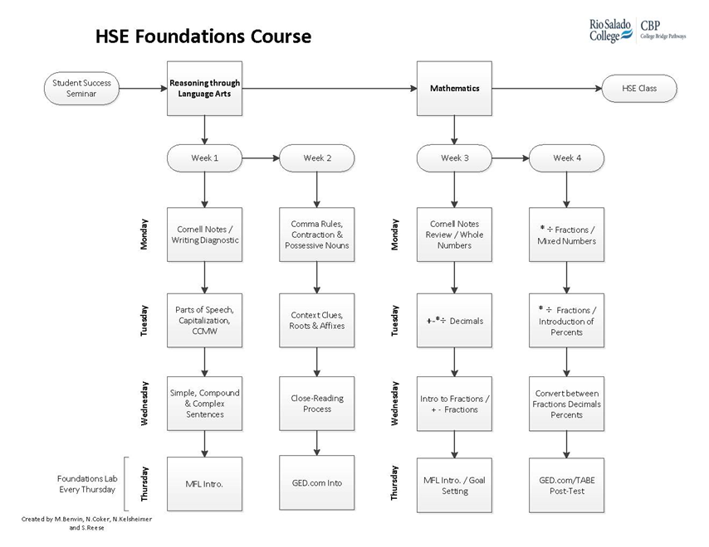
Foundations 2.0: The Structure
Notes:
Nicole

Slide 14
Foundations 2.0: ELA Curriculum
Why ELA first?
What do we teach?
Nouns, pronouns, verbs
Capitalization
Commonly confused/misspelled words
Simple, compound, complex sentences
Comma usage – the basic rules
Apostrophes
Context clues
Roots, affixes
Close-reading process
Answering text-dependent questions
Notes:
Nicole

Slide 15
Foundations 2.0: Math Curriculum
What do we teach?
The concept of part/whole reasoning expressed by, and procedural processes of:
Integers
Decimals
Fractions
Percents
Only converting between decimals, fractions, and percents
Notes:
Stephanie

Slide 16
Foundations 2.0: The Results
Pilot Location Data | 2015 | 2016
HSE Gains | 45% | 59%
Post-test Rate | 56% | 68%
Post-test Success | 80% | 86%
Student Retention* | 65% | 68%
Notes:
Stephanie

Slide 17
Foundations 2.0: Anecdotal Data
What the students say…
They feel more prepared to enter HSE classes.
Foundations needs to be longer.
They’d like more writing instruction.
What the instructors say…
They’re happy to not have new students every two weeks.
They’re better able to meet students’ needs.
Students come to them better prepared.
Notes:
Stephanie

Slide 18
Foundations 3.0: Looking at PY17
Working to increase instructional hours
Name change to “HSE I”
Continue to refine curriculum
Create training modules for new instructors
Working to ensure parity between locations
Notes:
Stephanie to check for accuracy

Slide 19
Foundations 3.0: Looking at PY17
Working to increase instructional hours
Name change to “HSE I”
Continue to refine curriculum
Create training modules for new instructors
Working to ensure parity between locations
Notes:
Stephanie to check for accuracy

