Slide 1
It’s Tech-Xtrodinary!!!
Link to Presentation:
goo.gl/QOhWXj
Becky Shiring
Professional Development Specialist
Carlos Rosario International PCS
@ beckyshy
eslbecky3@gmail.com
http://beckytecky.weebly.com/

Slide 2
Notes:
or https://www.youtube.com/watch?v=5Zui94M7E_c

Slide 3
Carlos Rosario International PUblic Charter School
Washington, DC
2000+ students
Adult immigrants
GED, citizenship, workforce, and ESL
Notes:
Becky

Slide 4
Today’s Meet
Use For:
*Burning Questions
*Suggestions
*Likes/Dislikes
*Feedback
https://todaysmeet.com/COABE
More Today’s Meet ideas here
Notes:
Support Lectures
Allow dialogue during video
Anonymous Q&A
Exit ticket
Dialogue between classes or with those not in the class
Brainstorm at the beginning of class
Feedback

Slide 5
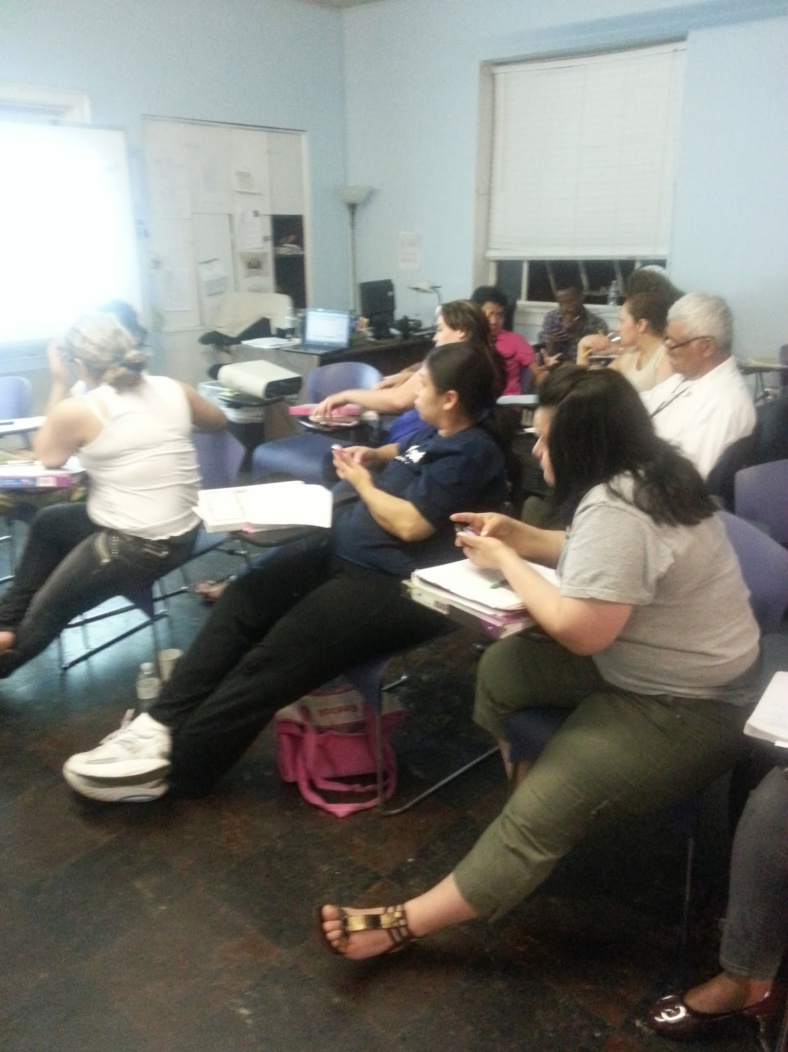
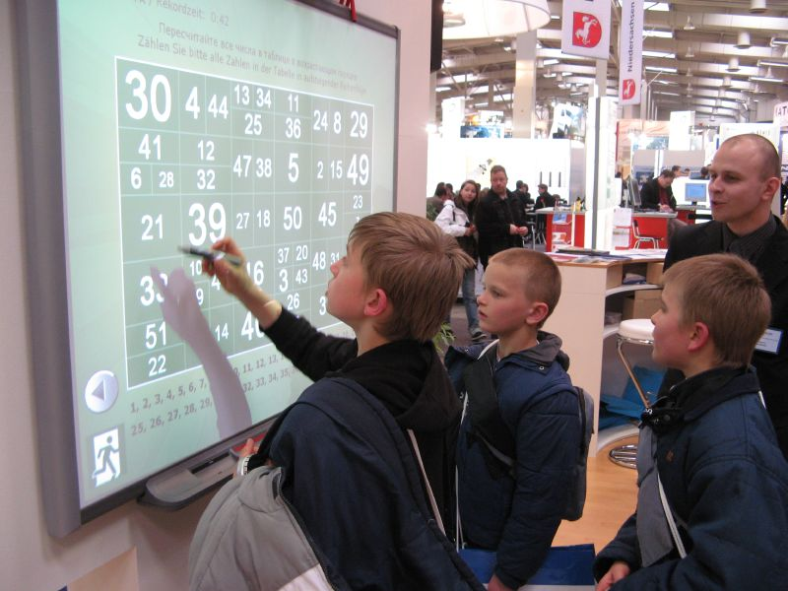
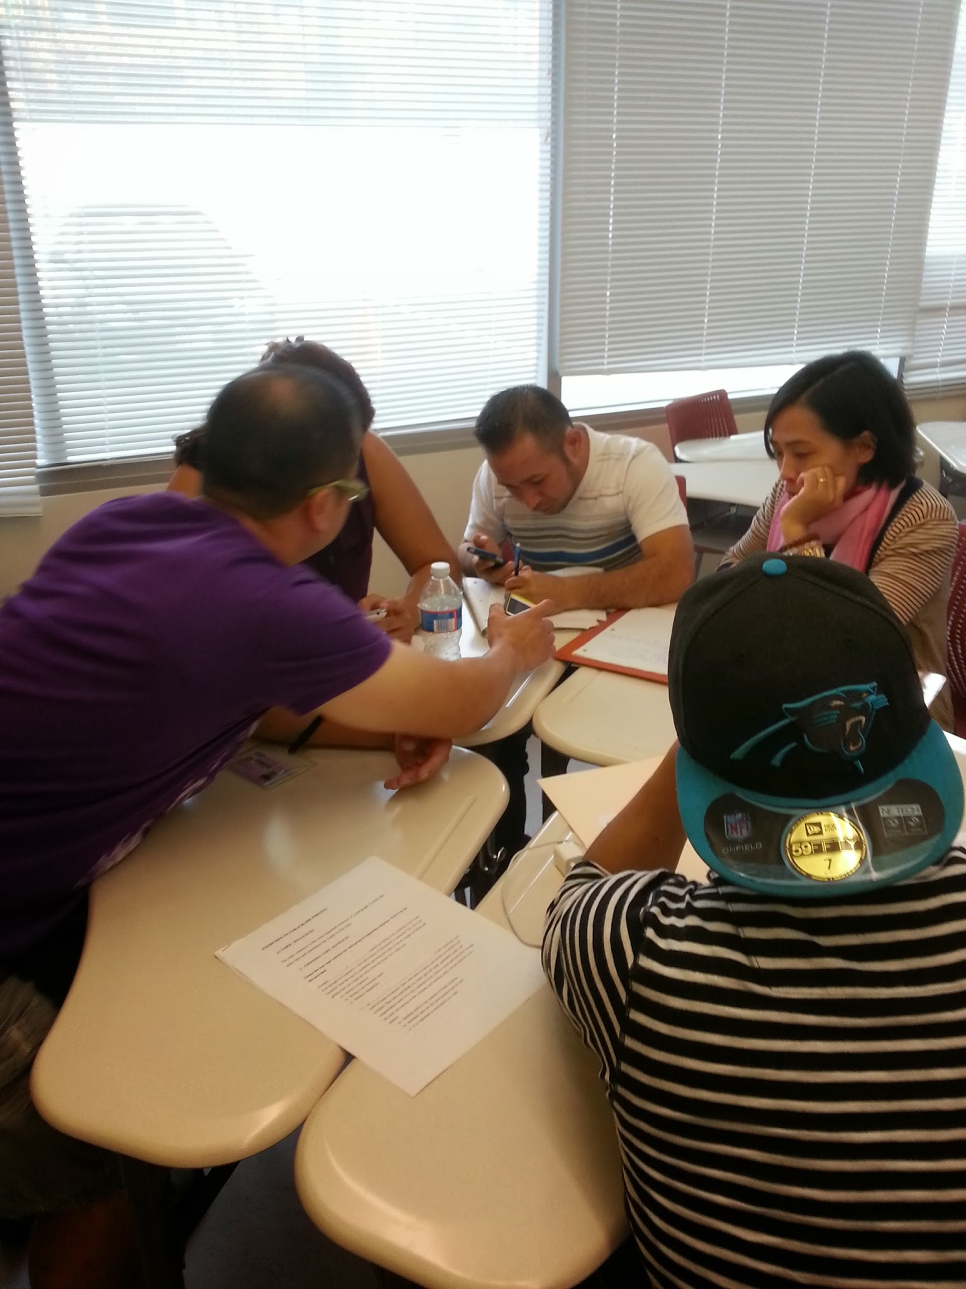
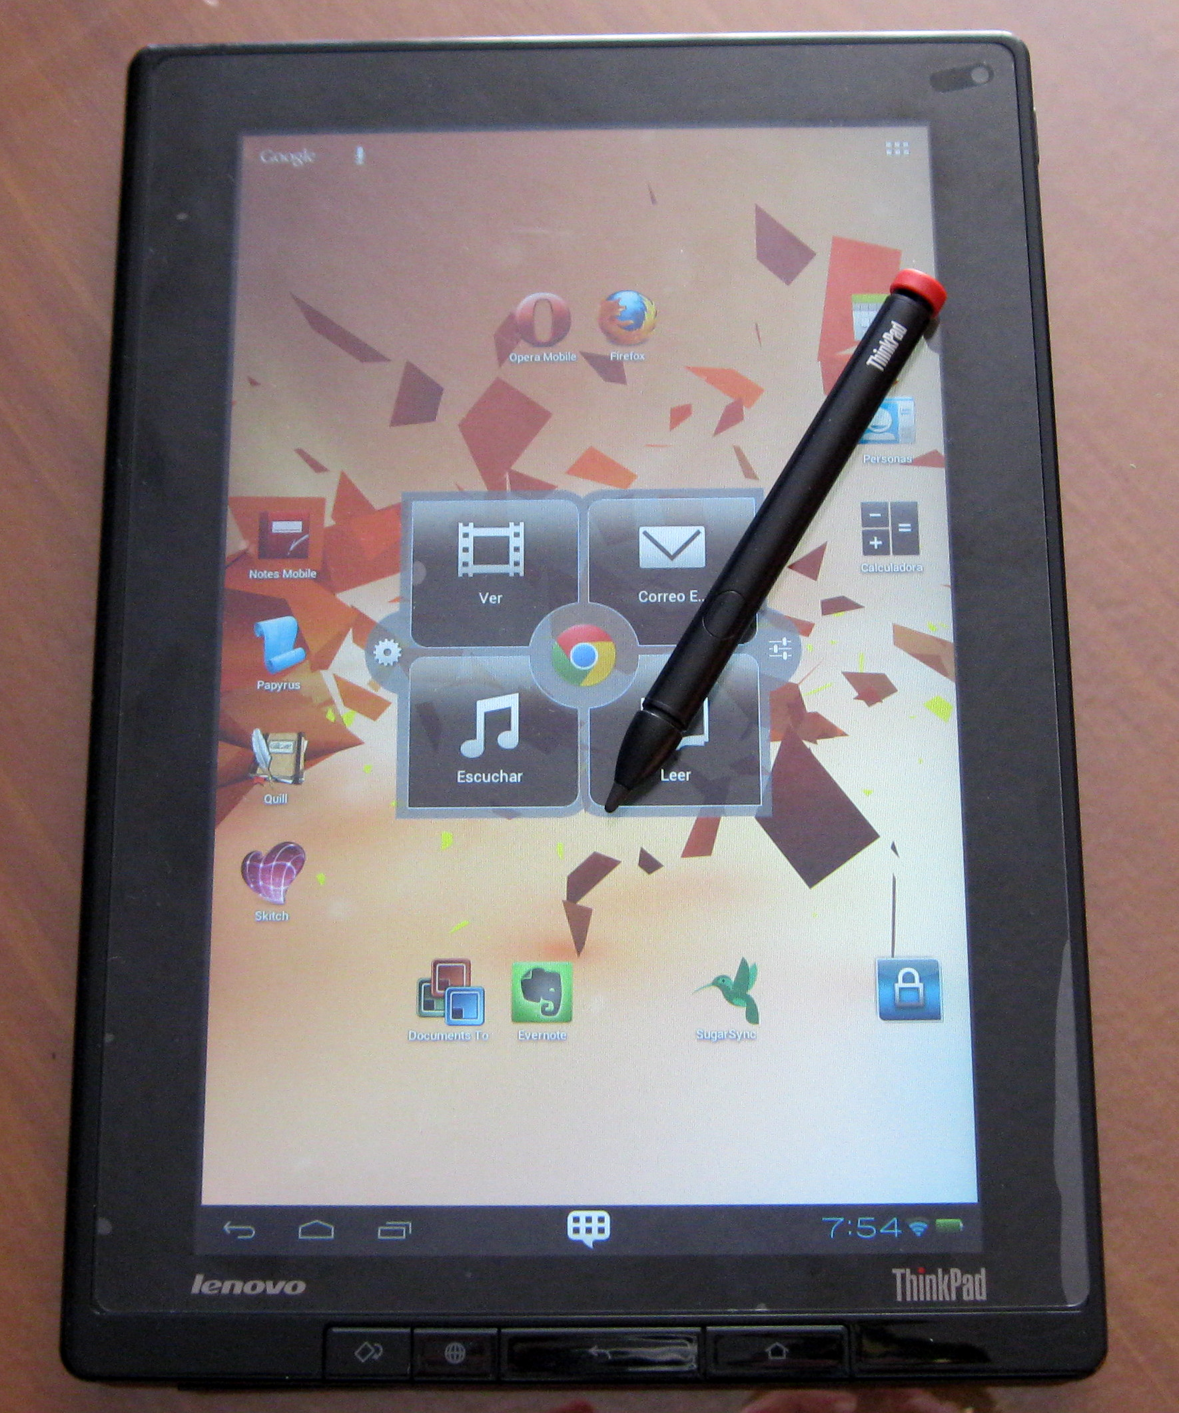
It’s not about the tools...It’s about the process, the collaboration, and the learning that takes place.

Slide 6
We are speed dating the tools and marrying the skills
Notes:
People ask how do we keep up with the changing speed of technology

Slide 7
Poll Everywhere: www.polleverywhere.com
Polls and quizzes sent via text, web, or twitter
Anonymous
Works with PowerPoint
Quick snapshot of student understanding or opinion
No smartphone needed
Notes:
Lindsey

Slide 8
Poll Everywhere
Let’s try it!
Text your response to
or visit PollEv.com/beckyshiring631
37607

Slide 9
Flickr: www.flickr.com
Photo sharing website
Great for pictures of class events
Gives a dummy email account (settings→ emails and notifications→your Flickr upload email)
Students can upload photos taken with smartphone
Photohunt activities
Connect field trip and classroom
Notes:
must have yahoo account
Becky

Slide 10
Storybird: www.storybird.com
Visual storytelling community
Create a class list, have Ss write a story based on a picture, share with class members
Read other students’ stories: http://storybird.com/chapters/alone-in-a-crowded-place/1/
Option to print for small fee
Notes:
Becky

Slide 11
GCF Learn Free
Real world English
Technology tutorials
Reading and Grammar
Life skills practice
Math
Work and Career
Learn English with instructions in Spanish, French, German, Arabic, Chinese, Portuguese, Korean, and simple English
Notes:
Lindsey
very high quality
laugh...simple English
variety of accents and reduced speech

Slide 12
NoRedInk
Grammar and writing exercises
Track student progress
Assign “interests” to a class to make sentences personalized
Rules for students to reference
Assign activities to specific students
Similar format to GED and TABE test
Allows students to “try a similar problem” when they answer incorrectly
Notes:
Lindsey

Slide 13
Learning Chocolate
Create vocabulary lessons
Add a picture and your words and the rest is automatic
Listening match, word to image match, dictation, fill in the blank
Example
Notes:
Lindsey

Slide 14
Lyrics Training
Beginner, Intermediate, Advanced, Expert
Karaoke
Automatically pauses for missed words
Repeat sections
Scored
Addictive!
Notes:
Becky

Slide 15
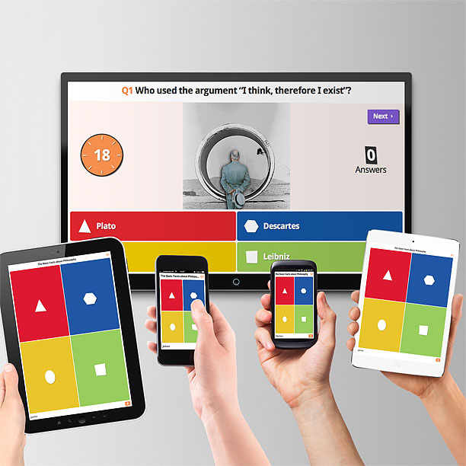
Kahoot: https://getkahoot.com/
Quizzes, Discussions, and Surveys
Game like, very engaging and fun
Instant feedback for teacher
Let’s try it:
Go to kahoot.it and enter access code
Notes:
Becky

Slide 16
EdPuzzle
Edit video clips to include questions
Students can listen multiple times and get immediate feedback
Track student scores
Record over video with your own commentary
Example

Slide 17
Wonderopolis
Wonder of the Day Article
Selected vocabulary words (with quiz)
Extension ideas for projects, additional resources
Comprehension Quiz
Discussion board
Teacher Resources
Pose your own wonder!
Notes:
-From National Centers for Family Learning
Becky

Slide 18
Bonus!!! (Teachers Pay Teachers)
Wonderopolis Graphic Organizer
Notes:
From teachers pay teachers

Slide 19
PicLit
Creative writing
Drag and drop or create your own content
Pre Selected words are related to picture
Ss learn new vocabulary
Notes:
Becky
Images change daily
Ideas for use: You can use PicLits to create all sorts of writing samples…here are just a few:
-simple/complex/compound sentence
-paragraph
-short story/narrative
-dialogue
-question
-informational/factual
-foreign language
-classroom assignment
-creative word placement
-caption
-song lyrics
-rap
-quotation (person/book/movie)
-postcard
-limerick
-haiku
-couplet
-journal entry
-holiday/special occasion
-free verse
-alliteration
-metaphor/simile
-personification
-rhyme
-ballad
-hyperbole
-palindrome

Slide 20
Padlet
Virtual bulletin board
Pre-lesson brainstorming
Exit tickets
Lesson Feedback
Vocabulary/Grammar
Unanswered Questions
Example
Click on the picture for more ideas!
Notes:
Lindsey
Ss don’t need account
Can add pictures
Word of the day

Slide 21
Thinglink
Create interactive images
Add links to video, sound, images, web pages
Example lesson
Student Activity
Resource Collection
Notes:
Becky

Slide 22
Tellagami
Notes:
Becky
can share email fb twitter or text

Slide 23
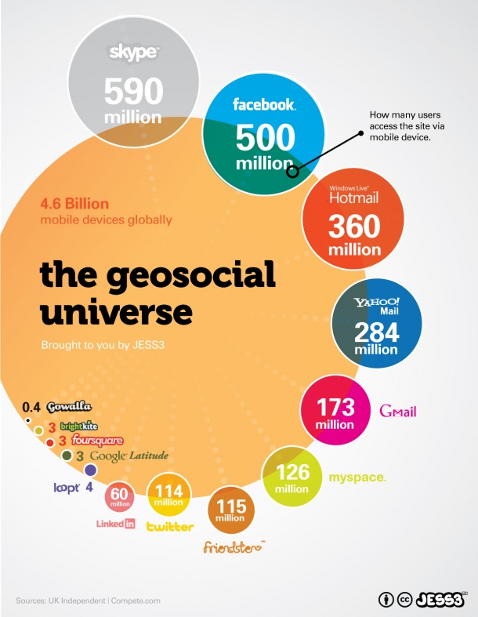
Canva
Super easy design program
Classroom/School Announcements
Illustrate concepts
Illustrate understanding of lesson
Design tutorials
Infographics
Notes:
Becky
Visualizing information which is 21st cent skill
Coaching menu: https://www.canva.com/design/DAA5Lo93kSA/8B9JBsdNDVlJza5QetorNQ/edit

Slide 24
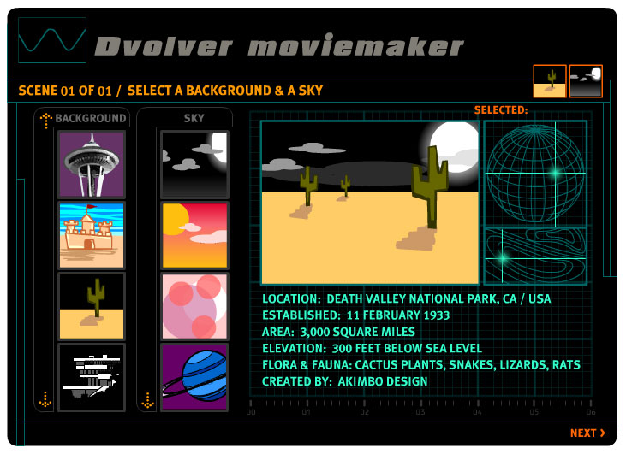
Devolver: www.dvolver.com
Easy to use movie making site
Great way to step up traditional dialogue creation activities
Student examples:
Restaurant dialogue activity
Modals activity
Notes:
Becky

Slide 25
Newsela: www.newsela.com
Real world current events adapted to students lexile level
Create a class, code for Ss to join
Quizzes to check comprehension
Pro version tracks students

Slide 26
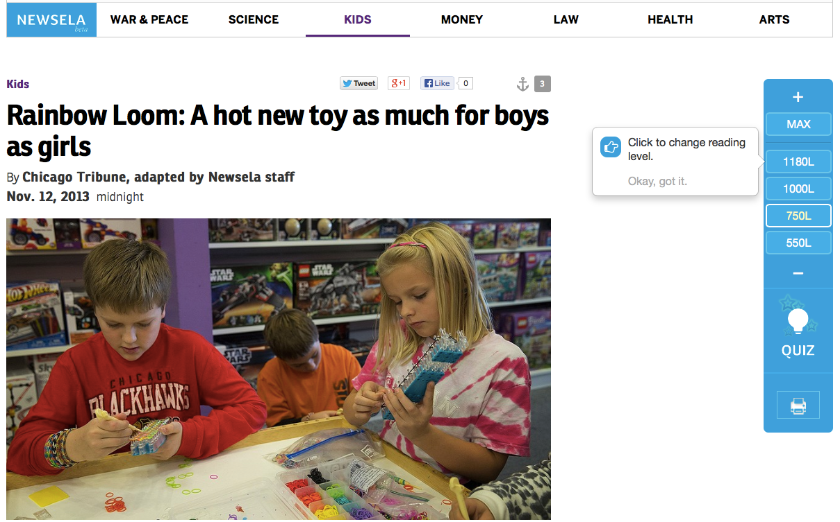
Notes:
Becky

Slide 27
Spreeder
Paste any text into Spreeder
Set speed, font, size, color
Whole class activity on projector
Individual on laptops, tablets, smart phones
Makes reading differentiation easy!
Notes:
Becky

Slide 28
Spreeder

Slide 29
Soundcloud: www.soundcloud.com
Cloud based sound storage
Record your voice and share:
pre-recorded dictations for students
student pronunciation practice
student produced “podcast”
Listen to thousands of uploaded songs and audio files
Notes:
Becky

Slide 30
Freesound.org: www.freesound.org
Database of Creative Commons licensed sounds
Use to bring life to a lesson
Guessing game with modals
Students can add sounds to presentations, stories, etc.
Write a story based on series of sound effects
Notes:
Becky
cat: http://www.freesound.org/people/tuberatanka/sounds/110011/
subway nyc: http://www.freesound.org/people/beman87/sounds/163141/

Slide 31
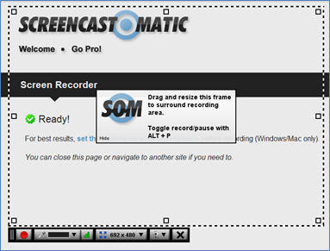
Screencast-o-matic: www.screencast-o-matic.com
Records screen movement and voice
Upload video to YouTube when finished
Create technology walkthroughs
Flip a lesson
Great for differentiation, students can watch as many times as needed
Use as a formative assessment
Notes:
Lindsey

