Slide 1
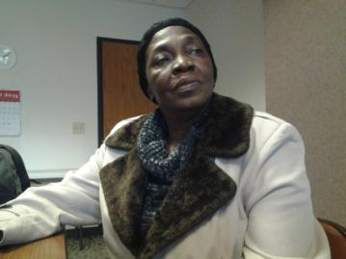
Scaffolds and Strategies for Emergent English Literacy Learners

Slide 2
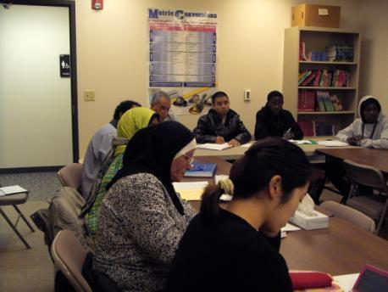
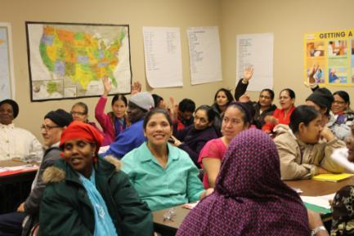
Backgrounds
Our Center

Slide 3
Center for New Americans LSS of SD
Resettlement provider since 1948
Lutheran Refugee and Immigration Service (LIRS) Partner
Sole refugee resettlement provider for the state of SD
400 refugees resettled per year

Slide 4
Center for New Americans LSS of SD
Unique One-Stop-Shop:
Case Management
Housing, Medical, Employment, Eligibility
Immigration Services
Community Interpreter Services
Education Program

Slide 5
Center for New Americans Education Program
Up to 49 classes daily
32 Instructors
900 – 1000 students annually
400 students daily
48 different countries
Common Student Ethnicities in 2015:
Bhutanese-Nepali, Somali, Congolese, Kunama (Eritrea), Karenni (Burma), Sudanese (South Sudan/Darfur), Ethiopian, Iraqi, Mexican, Guatemalan, El Salvadoran, Honduran and more…
Range of Educational Backgrounds

Slide 6
Emergent Readers
Unique Characteristics
Strengths
Goals/Motivations of Learners
Notes:
ESL Literacy Network- Bow Valley College in Calgary, Alberta, Canada~
-Have no or almost no formal education or familiarity with printed materials.
-Have few strategies for learning the written word.
-Are not familiar with the alphabet or have only a basic familiarity with it.
-May be able to spell their names without a model.
-Can read little other than their name or a few simple words.
-Often have no spoken English, but some may have developed speaking and listening skills.
Strengths! Jill Watson- strengths of oral cultures- orally developed cognition/memory, collectivistic, contextualized learning
Seeing all learners as having valuable strengths is a first step to improved instructional practice (Auerbach, 1995).
Clarice Esslinger- skills of estimation, advanced problem solving
Patsy- students are using learning strategies already “In another study of low-literate Hmong speakers, Reimer (2008) found that these learners were already using a number of learning strategies effectively, including using teachers and peers to help them learn and “focus[ing]their attention appropriately in the classroom” (p. 11).

Slide 7
Activity 2: Emergent readers acronym quiz
LESLLA
SLIFE
MALP
TESOL
Notes:
LESLLA: Low Educated Second Language and Literacy Acquisition
SLIFE: Students with Limited or Interrupted Formal Education
MALP: Mutually Adaptive Learning Paradigm
TESOL: Teaching English to Speakers of Other Languages International Association

Slide 8
The malp instructional model
DeCapua & Marshall, 2009, 2010; Marshall 1994, 1998

Slide 9
malp methodology
DeCapua & Marshall, 2010

Slide 10
malp methodology
How am I helping students develop and maintain interconnectedness?
How am I making this lesson immediately relevant to my students?
How am I scaffolding the written word through oral interaction?
How am I incorporating both group responsibility and individual accountability?
What new academic tasks am I introducing?
What am I dong to make the new tasks accessible to my students?
MALP Checklist of Six Key Questions for Teachers
DeCapua & Marshall, 2010

Slide 11
Activity #3: MALP in practice Train Your Brain!
Is it immediately relevant to SLIFE?
Is it practically accessible to SLIFE?
Identify what picture prompts you would use and other changes you would make.

Slide 12
MALP
Comic-sans or Century Gothic Fonts
Bold Print
20 Point Font
Extra Spacing
Number Sentences/Words
Photos Versus Drawings
Tips for SLIFE- friendly handouts

Slide 13
Whole-part-whole method
(Trupke-Bastidas, 2007)
Notes:
MALP – practically accessible and immediately relevant, scaffolds written word through oral interaction, WPW integrates these principals
Phonics and whole language have been widely debated for years in reading instruction circles. Research now indicates that the most effective teachers incorporate both aspects of reading instruction – practicing balanced literacy instruction!
WPW is one balanced literacy method that integrates bottom-up and top-down instruction within meaningful contexts.
Begin with a topic/theme that’s interesting/important/familiar to learners
Elicit words, phrases or stories from students – “learner generated story”
Teacher provides relevant vocabulary
Focus on some specific language features (sound/symbol correspondence)
Return to larger story/theme to build more oral/lit skills with reading, writing, storytelling, sharing

Slide 14
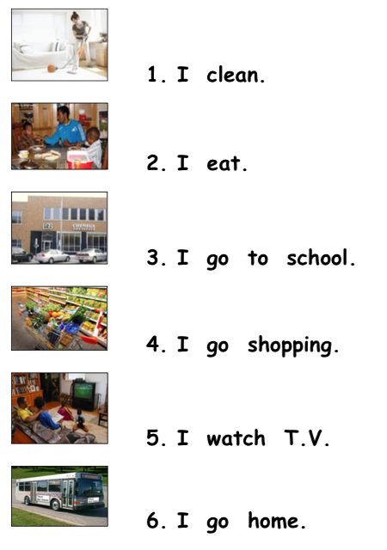
Lead With Oral into Literacy
Notes:
Oral-Patsy-
When working with second language learners who have limited literacy skills in any language, educators need to identify and utilize other strengths and resources that these learners bring to the learning situation, including their oral skills in English. Developing instructional activities that draw on their oral skills can help these learners improve their English literacy skills. (Auerbach, 1995).

Slide 15
learner-Generated Texts
“Using objects and experiences from their world provides a stronger basis for literacy learning.”
(Reymer, 2008)
“Learning should be contextualized and relevant and lessons should draw on actual experiences and concerns of learners.”
(Auerbach, 1992; Weinstein, 1999)
Notes:
Learner-generated text provide efficient technique for working with adults with limited literacy, because it connects oral communication to meaningful print (Crandall & Peyton, 1993).

Slide 16
Learner-Generated Texts
Language Experience Approach
Write about a photo/drawing
Picture Stories
Create text for a wordless picture book
Create a class photo book with captions
Make a class poster
Text Ideas

Slide 17
Learner-Generated Texts
Language Experience Approach
Text Ideas
Notes:
In LEA a teacher has the class take part in a hands-on group experience (planting tomatoes, trip to capital/library). Betsy Parrish – if impractical - use a sequence of pictures or retell event from their lives.
Teacher elicits orally from class what happened and writes it on board.
Transcribe verbatim for clear comprehension – this is what ss. understand orally
Make small changes, not change vocabulary or complex grammar so as to not alter meaning.

Slide 18
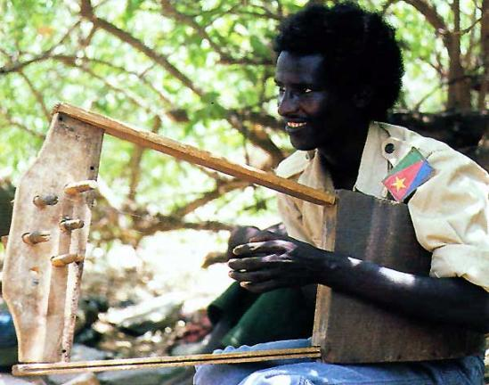
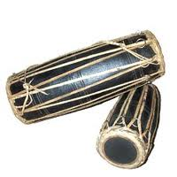
Learner-Generated Texts
Write About a Photo/Drawing
Text Ideas

Slide 19
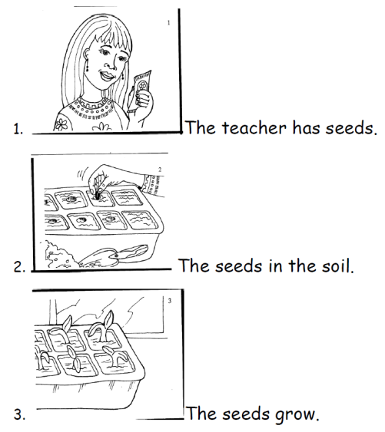
Learner-Generated Texts
Picture Stories
Text Ideas

Slide 20
Learner-Generated Texts
How to Generate a Simple Text from Learners Using Questions

Slide 21
Learner-Generated Texts
How to Generate a Simple Text from Learners Using Questions

Slide 22
Learner-Generated Texts
Examples: The Market Level B

Slide 23
Learner-Generated Texts
Examples: The Market Level A

Slide 24
Activity #4: Reflect on Learner-generated text
How have you used learner-generated texts?
What are some themes/topics of interest and importance to your learners that you could use to elicit learner-generated texts?

Slide 25
Parts Work: literacy skills
Phonemic Awareness
Phonics
Word Recognition
Sequencing

Slide 26
Activity #6: Emergent reading skills quiz
Comprehension
Phonological Awareness
Phonemic Awareness
Phonics
Concept of Word
Concept of Print
Letter/Sound Relationship
Notes:
Comprehension c. Understanding of text supported by background knowledge, gestures and pictures.
Phonological Awareness a. The ability to identify and manipulate spoken language.
Phonemic Awareness e. The ability to identify and manipulate individual sounds in words.
Phonics g. Understanding the relationship between phonemes (units of sound) and graphemes (letters/digraphs).
Concept of Word b. Includes the ability to identify individual words, spaces between words and the number of words in a sentence.
Concept of Print f. An understanding that print carries meaning.
Letter/Sound Relationship d. Knowing that one specific letter represents one sound.

Slide 27
Parts Work: literacy skills
Where’s the Sound?
What is the 1st/Middle/Last Sound?
Blend the Word
Rhyming Words
Letter Substitutions
How Many Parts? (Syllable Identification)
Phonemic Awareness
Activities

Slide 28
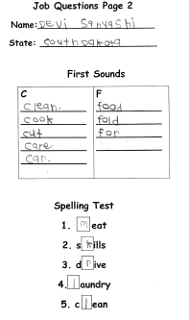
Parts Work: Phonics
Word Sort
Missing Letter Fill-In
Simplified Dictation
Word Families
“Slow Reading”

Slide 29
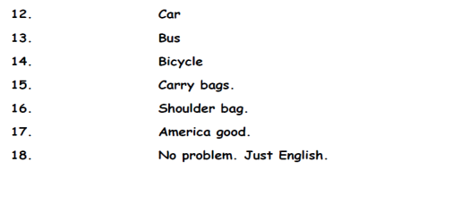
Parts Work: Phonics
“Slow Reading”

Slide 30
Parts Work: literacy skills
Circle Repeated Words
Choose the Word You Hear
Flyswatter Game
Same or Different?
Word Recognition

Slide 31
Parts Work: literacy skills
Stand Up and Sequence
Pocket Chart
Order the Words/Story (Pairs)
Order the Words/Story (Individuals)
Scaffolded Sequencing
Activities

Slide 32
Parts Work: literacy skills
Letter Formation
Spelling Practice
Writing
Activities

Slide 33
Parts Work: literacy skills
Writing
Activities

Slide 34
Parts Work: literacy skills
Writing Activities
Notes:
21 sec. video, cut at 10 sec.
This learner is using the spelling study strategy to “self correct”
Ultimate goal of scaffolding is an independent and self-regulating learner – this student may need reminders but has internalized this skill

Slide 35
Whole part Whole
Repeated Reading
Independent Reading
Retelling the Story
Question Work
Vocabulary/Topic Extension
Whole Work

Slide 36
Class Routine
-Attendance
-Exercise
-Calendars
-Sight Word Practice
-“Whole” activities
-“Parts” activities
-Homework Instruction
-Closing Chant
Kadie’s Foundation Level A Class

Slide 37
Routine in lesson structure
Objective/Demonstration
Attendance
Warm-Up: Elicit learner-generated content
Pair Reading Practice/Check homework
Working With Parts:
Phonics
Phonemic Awareness
Sight Word Recognition
Sequencing
Open class reading practice
Independent Reading
Homework Assignment
Laura’s Emergent Reading Level B Class

Slide 38
Routine in lesson structure
abc English,
Jennifer Christenson
Notes:
Jennifer Christenson, author of abc English writes: “Emergent readers learn best when there is a predictable lesson structure. Routine helps students understand what to expect during class and gives students a framework for organizing new knowledge.”
Jennifer’s sample lesson outline includes:
-Intro Activities: calendar/weather
-A daily phonics review with 5 Phonics Foundational Skills which she suggests recycling weekly.
-A pre-reading vocabulary lesson including thorough listening and speaking practice.
-A group reading activity (to included modeling of reading strategies and techniques for sounding out words)
-Post-reading activities: Learner-generation of learned text to the board, learners copy into notebooks; independent reading time (pairs/individual) of printed text
-Spelling practice: reinforce phonics, reading and writing concepts (Example: word family lists)
-Competency checklist activities: address
Standards-based activities: technology/workplace English

Slide 39
Activity #7: Reflect on Class Routine
1. What kinds of routines do you integrate into instruction that support learning for SLIFE?
2. Name one element of routine you would like to add to your instruction.

Slide 40
Scaffolding
Scaffolded instruction is “the systematic sequencing of prompted content materials, tasks and teacher and peer support to optimize learning.”
(Dickson, Chard and Simmons, 1993)
Notes:
4 steps:
Teacher offers assistance with skills beyond the students’ abilities
With teacher’s supports the students achieve the task
As students master tasks, scaffolding is gradually removed (fading)
Students work independently

Slide 41
Scaffolding Tools
Simple prompts
Relatable examples
Modeling
Visual Aides
Step-by-step process
Break task into smaller parts
Check understanding
Elicitation

Slide 42
Scaffolding Tools
Repeat & Recycle
“Don’t sacrifice depth for the sake of breadth.”

Slide 43
Scaffolding
Pre-assess the students’ needs and curriculum
Begin by boosting confidence
Establish a shared goal
Facilitate frequent success
Help students “fit in”
Avoid Boredom
Remove scaffolding
Guidelines
Larkin, 2002

Slide 44
Scaffolding Throughout a Lesson
FRAMEWORK
TEACHER PROMPTS
The Class Does It
The Teacher Does It
The Class Does It
The Group Does It
The Individual Does It
“Everybody…”
“Look at the teacher. Look at the board.”
“ Everybody together…”
“Two students. One paper. No teacher.”
“One student. No teacher. The teacher will listen.”

Slide 45
Scaffolding Throughout a Lesson
LESSON PLAN STAGES
FRAMEWORK
Warm-Up/Elicitation
Presentation/Modeling
Initial Guided Practice
Semi-Guided Practice
Monitored Pair Practice
Application/Free Practice
We Do/No Teacher
I Do/No Students
We Do/With Teacher
We Do/No Teacher
You Do/No Teacher
You Do Alone/Sans Scaffolds

Slide 46
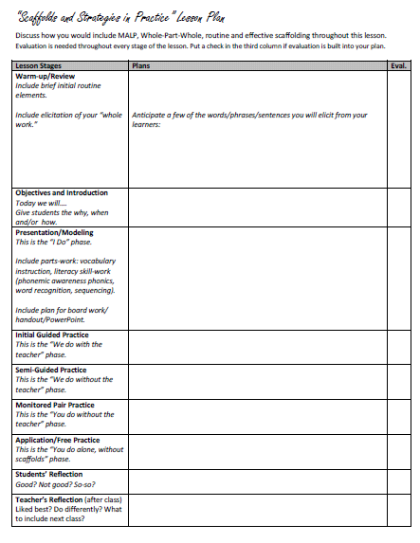
Activity #8: Write an emergent literacy lesson plan
Learner Generated
Text Topic:
“What do you do everyday?”
MALP
Whole-Part-Whole
Lead With Oral Into Literacy
Learner-Generated Texts
Literacy Activities
Class Routines
Effective Scaffolding

Slide 47
Recommended Resources
http://www.teachabcenglish.com
http://www.esl-literacy.com
http://www.multilingualminnesota.org
http://www.cal.org/caelanetwork/resources/using-oral-language-skills.html
Croydan, A. 2005. Making it real: Teaching pre-literate adult refugee students. Tacoma, WA: Tacoma Community House Training Project
Notes:
As we wrap up/draw your attention to…

Slide 48
Recommended Materials
abc English Book One and Teacher’s Activity Guide, 2013, by Jennifer Christenson
abc English Book Two and Teacher’s Activity Guide, 2013, by Jennifer Christenson
Sam and Pat Book 1: Beginning Reading and Writing, 2005, by Jo Anne Hartel, Betsy Lowry, Whit Hendon
Sequences: Picture Stories for ESL, 2006 by John Chabot

Slide 49
References
Bigelow, M. & Schwarz, R. 2010. Adult English language learners with limited literacy. Washington, DC: National Institute for Literacy. Retrieved from https://lincs.ed.gov/publications/pdf/ELLpaper2010.pdf
Larkin, M. 2002. Using scaffolded instruction to optimize learning. Arlington, VA. ERIC Clearinghouse. Retrieved from http://www.vtaide.com/png/ERIC/Scaffolding.htm.
Marshall, H. DeCapua, A. and Antolini C. 2010. Engaging English language learners with limited or interrupted formal education. Latham, NY: Educator’s Voice Vol. III. Retrieved from http://www.nysut.org/~/media/files/nysut/resources/2010/may/educators-voice-3-adolescents/educatorsvoice3_adolescents.pdf?la=en
Parrish, B. 2004. Teaching adult ESL, a practical introduction. New York: McGraw-Hill.
Reyhner, J. 2008. The reading wars: Phonics versus whole language. Flagstaff, AZ: Northern Arizona University. Retrieved from http://jan.ucc.nau.edu/jar/Reading_Wars.html
Trupke-Bastidas, J. & Poulos, A. (2007) Improving literacy of L1-non-literate and L1-literate adult English as a second language learners. Minne/WITESOL Journal, 25. Retrieved from http://minnetesol.org/journal/articles/improvingliteracy.html
Vinogradov, P. & Bigelow, M. 2010. Using oral language skills to build on the emerging literacy of adult English learners. Minneapolis, MN: University of Minnesota. Retrieved from http://minnetesol.org/journal/articles/improvingliteracy.html

