Slide 1
A Tool for Teaching Functions and Graphs
Amy Vickers
www.elevatingadulteducation.com
amyjvickers@gmail.com

Slide 2
Objectives
Make connections among components of functions and graphing by completing the Exploring Functions and Graphing worksheet
Use the Exploring Functions and Graphing worksheet in a way that makes sense in your classroom.
Modify Exploring and Graphing Functions worksheet for various levels.

Slide 3
Background
Adult diploma algebra class
Modified several times by me and by colleagues
Continues to be shared and modified
Shared with teachers in MN
Shared at last year’s COABE conference as part of a GED prep session

Slide 4
EMPower Math Books

Slide 5
Focus, coherence, rigor
College and career readiness standards for mathematics
Key shifts

Slide 6
Front of sheet
beginner

Slide 7
Back of sheet
advanced

Slide 8
Plan for the session
Go through one full example together
This may go beyond the level that you teach—please help each other as needed
Choice: Try beginner or advanced example in small groups or on your own
Take worksheets with you to use in your own context

Slide 9
Example
Annie is planning a business meeting for her company. The cost of the meeting room is $270 and each lunch costs $41. How could she figure out the total cost of the meeting?

Slide 12
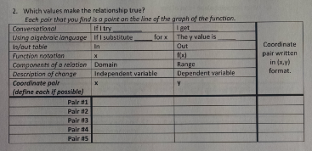

Slide 13
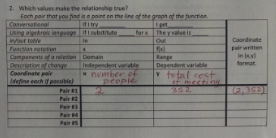

Slide 14
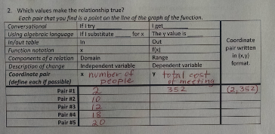

Slide 15
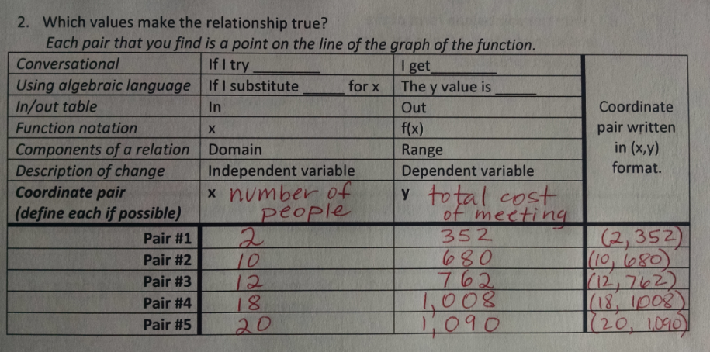

Slide 16
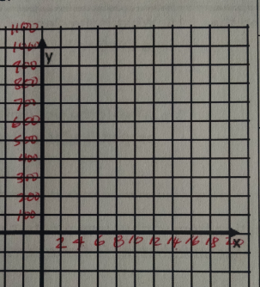

Slide 17
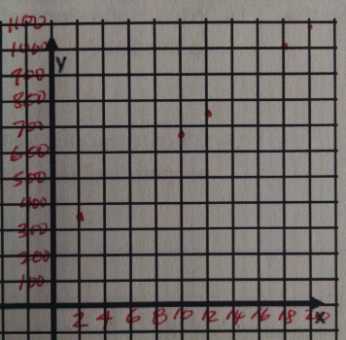

Slide 18
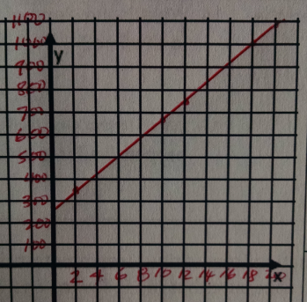

Slide 19
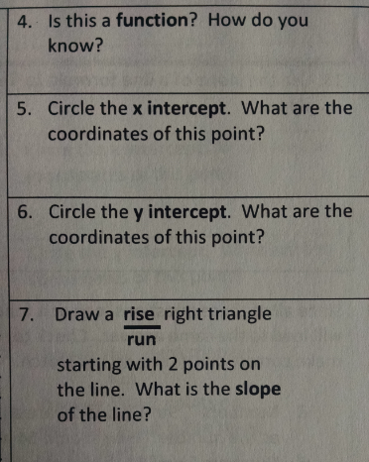

Slide 22
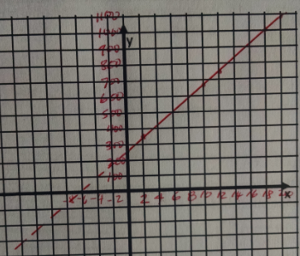

Slide 23
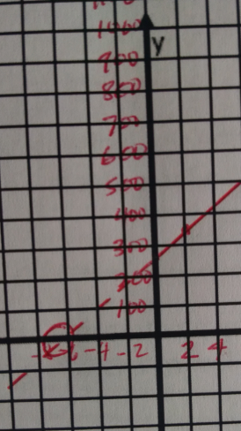

Slide 24
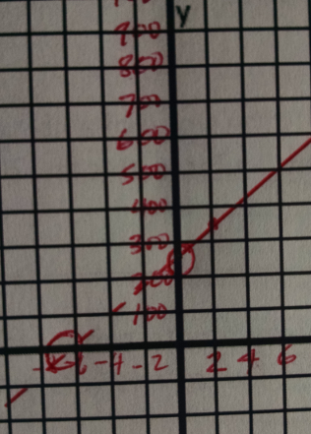
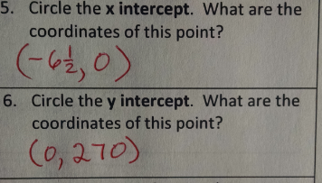

Slide 26
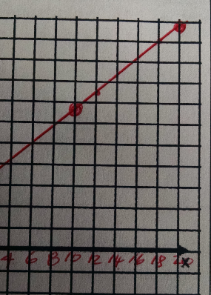

Slide 27
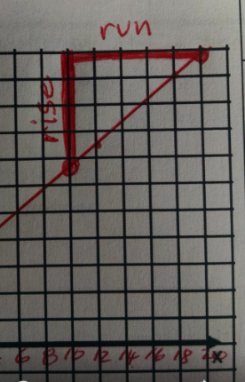
rise = 410 = 41
run 10
slope = 41

Slide 28
Example
Annie is planning a business meeting for her company. The cost of the meeting room is $270 and each lunch costs $41. How could she figure out the total cost of the meeting?

Slide 29
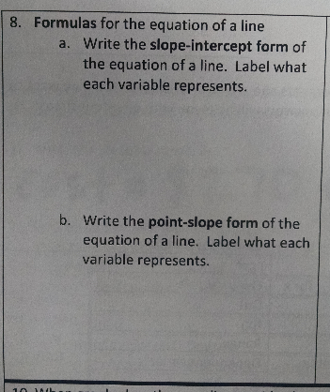

Slide 30
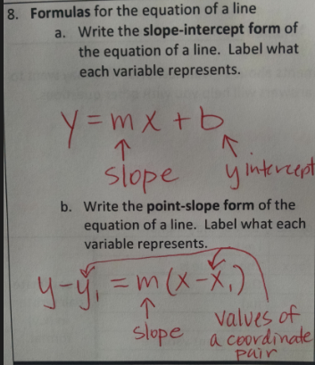

Slide 31
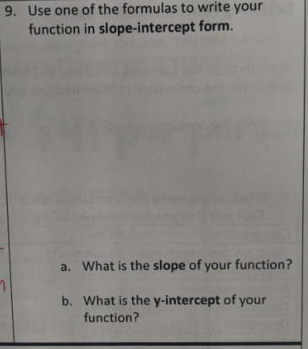

Slide 32
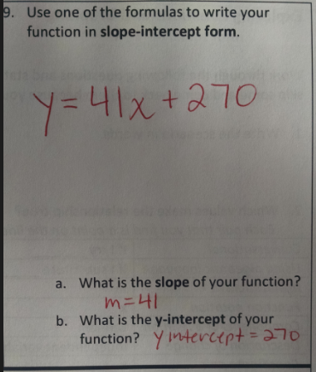

Slide 36
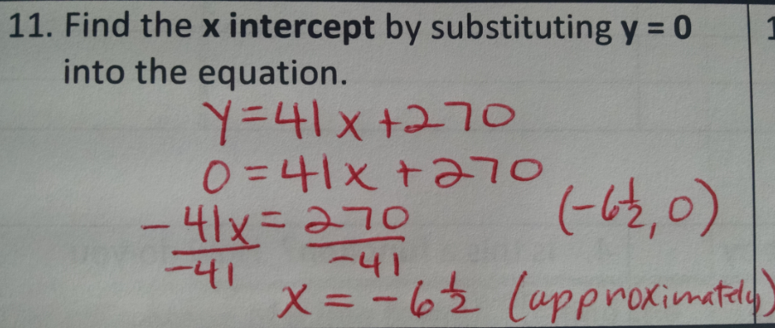
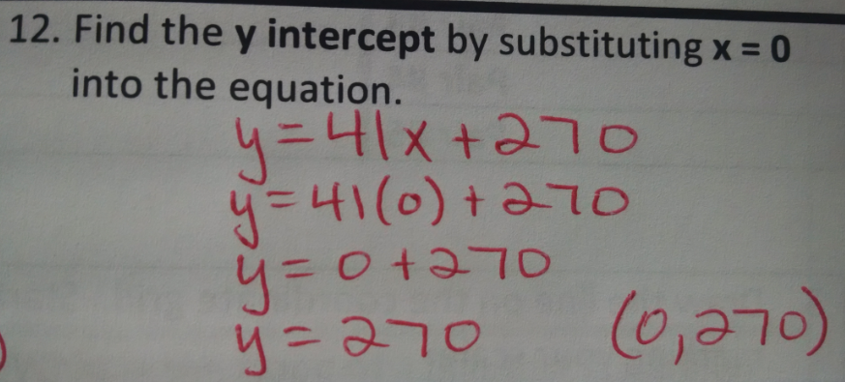

Slide 37
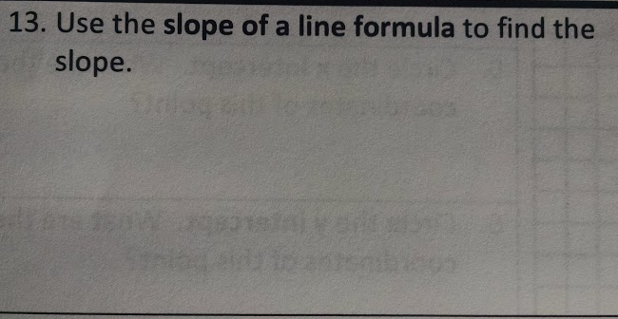

Slide 38
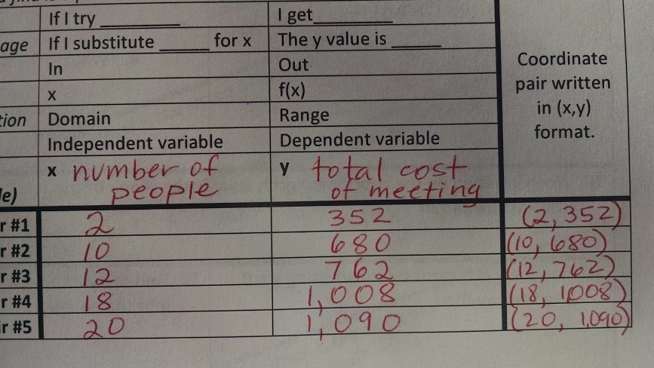

Slide 39
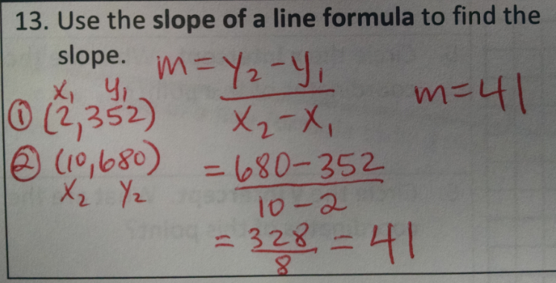

Slide 40
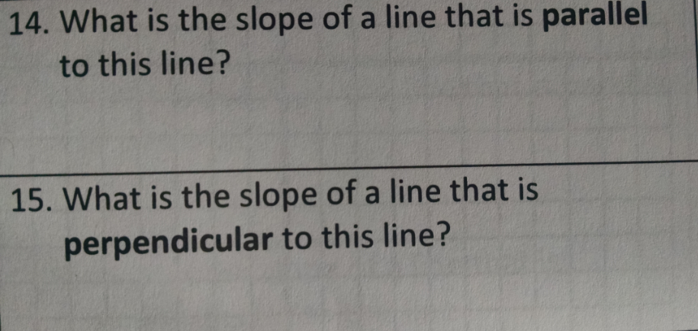

Slide 41
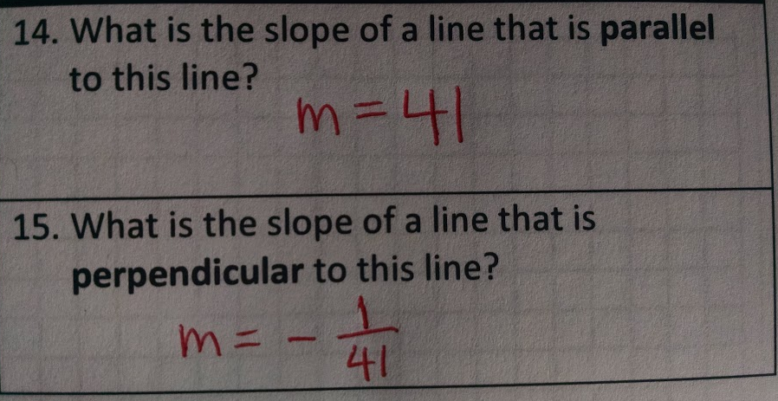

Slide 43
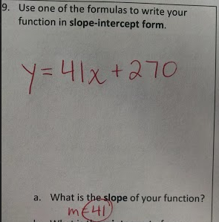
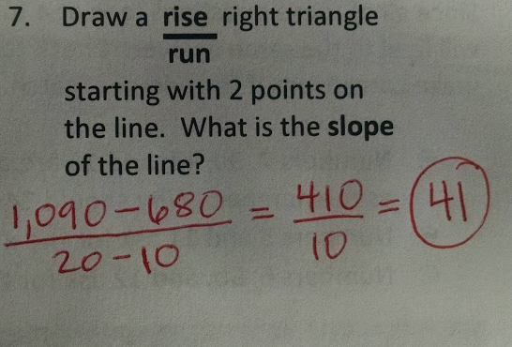
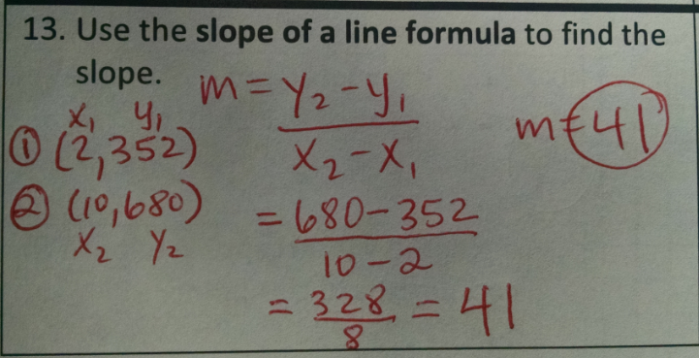

Slide 49
How can this be useful in your classroom?
Great practice
Works in multi-level classroom
Students will discover connections at their own pace
Students develop persistence and ownership
Higher level algebra made more accessible
Easy prep. Teacher provides prompt, then can spending time asking facilitation questions to individuals or groups to deepen understanding
Challenges
Emphasizes mechanics, lacking in emphasis on conceptual understanding
Students will need guidance and explanations at first

Slide 50
More practice #1
Beginner, complete the front page only
Advanced, complete the front and back
Use these 3 points to complete the page:
(3,7)
(5, 11)
(6, 13)
Hint: look for the relationship between each x and y
y = 3/4 x - 8
Hint: Start anywhere on the front or back. Work from there.

Slide 51
More practice #2
Beginner, complete the front page only
Advanced, complete the front and back
For a meeting I spent $48. I rented a projector for $40 and bought 2 boxes of Girl Scout cookies for $8.
The next month, I expected a larger group and spent $56-- $40 for the projector and $16 for 4 boxes of Girl Scout cookies.
How much would I spend for the meeting if I bought 5 boxes of cookies?
Hartley opened a food truck business to sell food on the street. On day 2, the business earned $112. On day 5, the business earned $367. Hartley assumes that the earnings will continue to increase at the same rate. How much will the business earn on day 10?

Slide 52
Thank you!
Amy Vickers
www.elevatingadulteducation.com
amyjvickers@gmail.com

