Slide 1
Adult Literacy through Libraries: Building a National Movement
Presenters:
Alicia Suskin, ProLiteracy
Kristin Lahurd, American Library Association
April 13, 2016

Slide 2
Workshop Objectives
• Understand the structure and purpose of the Adult Literacy through Libraries Action Agenda
• Learn practical strategies for expanding adult literacy services through libraries
• See examples of libraries creating and implementing tailored action plans
• Become oriented to the free online course that will guide you through putting the Agenda into action

Slide 3
Adult Literacy and Libraries: A Natural Partnership
Early 1900s: Libraries as social educators
1991: White House Conference on Libraries and Information Services
1990s: Wallace Grants

Slide 4
Adult Literacy through Libraries Action Agenda

Slide 6
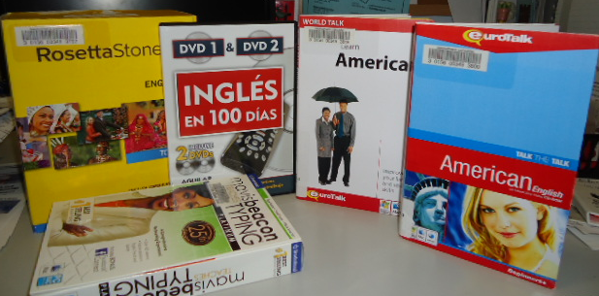
Collection Development
Outcome 1.1: Library collections include print and digital materials that meet the readability needs, goals, and interests of adult learners and the instructional resource needs of adult educators.
Action Recommendations:
Create a collection development policy that includes procurement of print and/or digital materials for adult learners.
Train collection development and acquisition staff to effectively identify and source print and digital materials suitable for adult learners and adult educator.

Slide 7
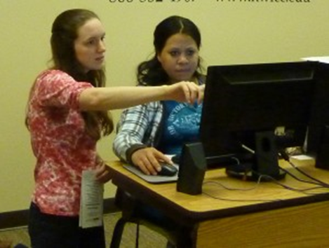
Technology and Digital Literacy
Outcome 2.5: Librarians help adult learners understand how to access the technology resources available to them in their
community.
Action Recommendation:
Provide assistance and information to help adults with limited literacy skills identify the purposes for which they want to use technology.

Slide 8
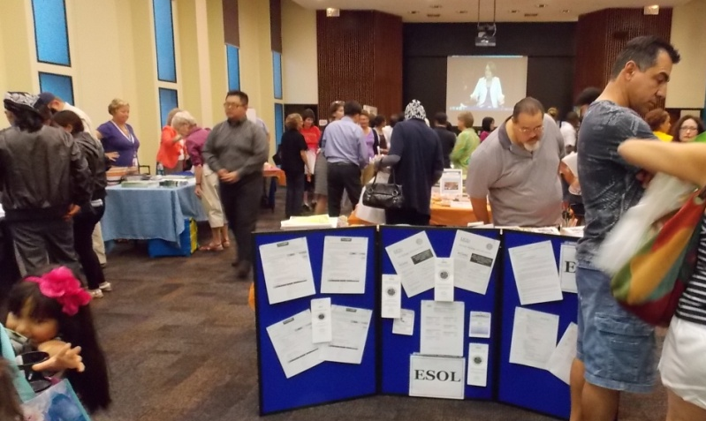
Collaboration and Strategic Partnerships
Outcome 3.5: Libraries and adult instruction programs reach beyond initial or traditional partnerships and increase and/or maintain new/nontraditional partnerships within the community.
Action Recommendation:
Work with adult instruction programs to network with other community agencies that do not normally provide literacy instruction but are likely to serve adults with literacy needs.

Slide 10
Phase Two
National Advisory Group
Three library pilot sites
Online course and resources
National rollout

Slide 11
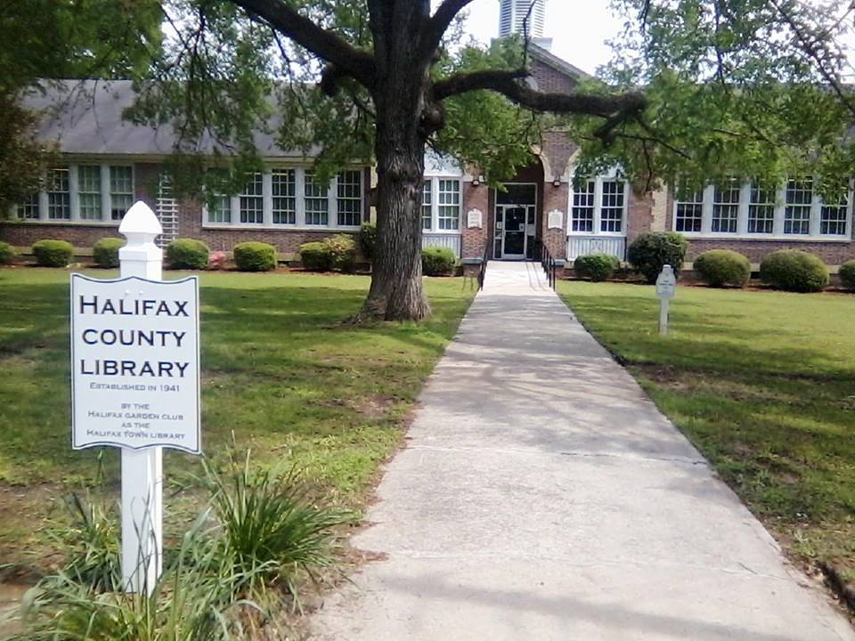
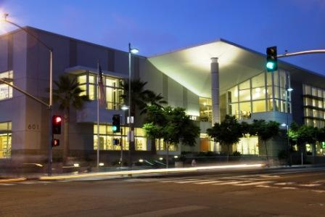
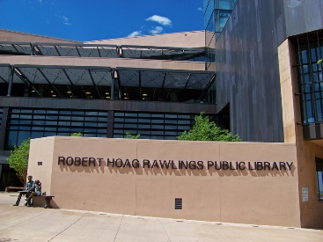
Library Pilots
Halifax County Library
Halifax, NC
Santa Monica Public Library
Santa Monica, CA
Rawlings Pueblo
City-County Library
Pueblo, CO

Slide 12
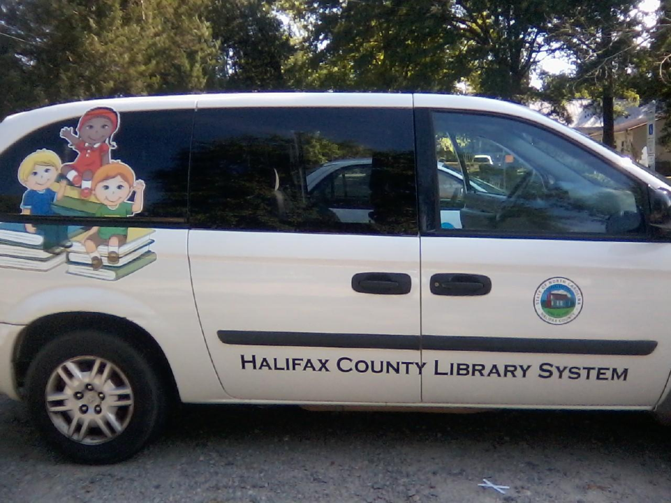
Halifax County Library
Rural library system
Main library and four branches (10 full-time employees)
27.4% of population below poverty level
No adult literacy program in place
No established community network
Community college is core of adult literacy services
Library seeks to supplement, contribute
to existing services
Limited resources (staff, $) → start small

Slide 13
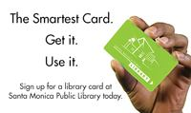
Santa Monica Public Library
LA County (urban/suburban)
Affluent community but population is changing: more new immigrants, day workers, people experiencing homelessness
Library seeks to provide services for all
No adult literacy program in place
Community assessment
Strategic plan
Establish literacy coalition or task force

Slide 14
Rawlings Pueblo City-County Library
Urban
Large library system (65 full-time employees)
19.1% of population below poverty level
42.3% identify as Latino/a; 14.6% speak a language other than English
Established an Adult Literacy Coordinator position
Expansive adult literacy programming (ESL, digital literacy, jobs)
Extend reach beyond library

Slide 15
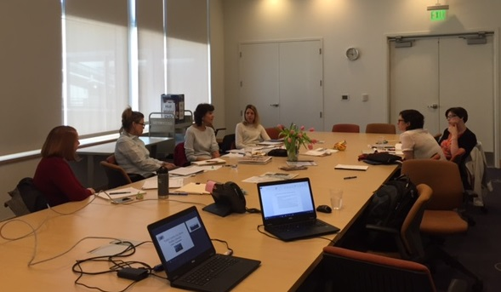
Pilot Site Meeting
Santa Monica: surveying adults experiencing homelessness
Halifax: initial outreach: structured interviews with community leaders and branch librarians
Rawlings: new Adult Literacy Coordinator, new goals

Slide 16
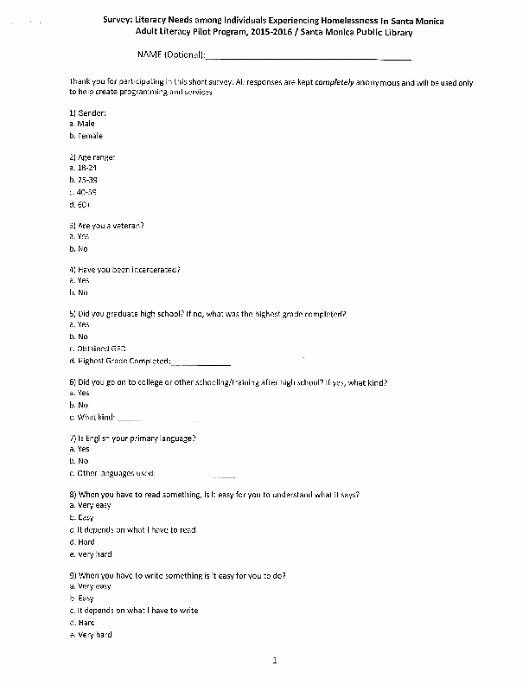
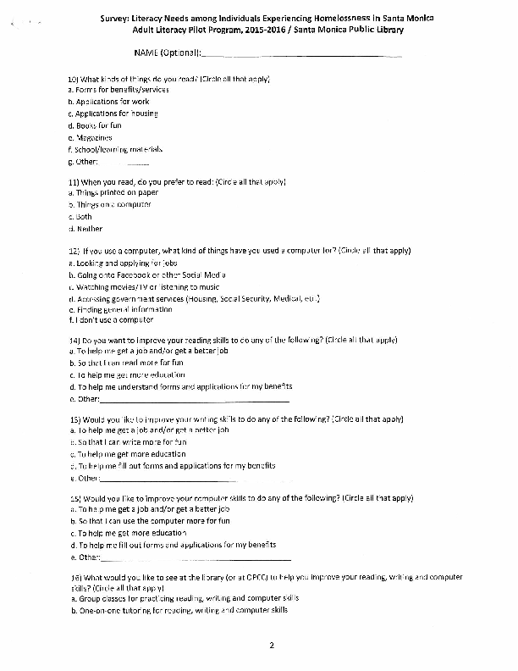

Slide 17
Online Course and Resources

Slide 18
National Rollout

Slide 19
Discussion
What is the adult literacy landscape in your community? What partnerships have you formed to address the need?
What initiatives would you like to undertake in the future?
What kinds of barriers have you experienced or do you anticipate when undertaking these initiatives?
What are some ideas for how to overcome the barriers? Supports needed?
What role do you see for your library and others in building a national movement around adult literacy?

Slide 20
Resources
National Literacy Directory
www.nationalliteracydirectory.org
ALA Office for Diversity, Literacy and Outreach Services
http://www.ala.org/diversity
ProLiteracy Education Network
www.proliteracyednet.org
PIAAC
http://nces.ed.gov/surveys/piaac/
IMLS
http://www.imls.gov/
LINCS Literacy Information and Communication System
http://lincs.ed.gov/
Thank you!
Alicia Suskin asuskin@proliteracy.org
Kristin Lahurd klahurd@ala.org

