Slide 1
TRAIN Tex: Innovations in Professional Development
Lori Slayton and John Stevenson
Adult Education and Literacy Texas Workforce Commission
April 11 , 2016

Slide 2
Overview
WIOA
Evolution of PD System
PD Needs in Texas
TRAIN Tex Model
How does TRAIN Tex Work?

Slide 3
WIOA underscores what we have been doing
The law positions Adult Education and Literacy to:
Play an integral role within a broader, interconnected workforce development system
Deliver greater access to educational services for our customers through the Texas Workforce Solutions delivery system
Increase opportunities for a broader array of services available to students
Promote transitions at all levels to postsecondary education and training or employment

Slide 4
PD Needs
AEL Grantees
Non-funded Providers
Workforce Boards
Employers
Notes:
AEL Grantees - 3577 AEL Grantee Staff received PD in 2014-2015; averaging 33 hours per participant; median was 24. 74% were teachers; 17% were administrators or supervisors
Non-funded Providers – 629 participants to Literacy Texas Events since August 2015; serving more than 54 non-funded literacy providers
Workforce Boards - 10 workforce & Adult Education Integration Events from May 7 to June 29, 2015, including all 28 workforce boards and all 34 AEL grantees

Slide 5
Evolution
Eight regional GREAT Centers
TRAIN PD Consortium
TRAIN Tex

Slide 6
AEL Grantees … last year
34 AEL Grantees
Served 87,644 students in 2014-2015
3,577 staff
Required PD hours 12 to 24
Average PD hours -- 33
Median PD hours – 24
74% were teachers
17% were administrators or supervisors

Slide 7
Non-Funded Providers … so far this year
Annual Literacy Texas Conference attended by 65 nonprofit organizations with 319 attendees
Four Literacy Texas regional symposia through February attended by 83 nonprofits with 310 attendees
Workforce & Adult Education Integration Initiative, consisting of 10 events, including all 28 Workforce Boards and affiliated AEL programs
Statewide AEL/TWC Combined Conference
Notes:
Non-funded Providers – 629 participants to Literacy Texas Events since August 2015; serving more than 54 non-funded literacy providers
Workforce Boards - 10 workforce & Adult Education Integration Events from May 7 to June 29, 2015, including all 28 workforce boards and all 34 AEL grantees

Slide 8
2
TRAIN Tex
Training, Resource and Innovation Network for Texas
Texas Workforce Commission
Career Pathways Expansion
HCCS
PD & Program Integration Efforts with Non-Profits Literacy Texas OneStar Foundation
Public Library AEL Expansion Texas State Library and Archives Commission
Professional Development Center
Distance
Learning
Mentor Initiative
College of the Mainland
Northside ISD
Assessment & Standards Initiative
Texas State University
Focus on the Basics Reading & Math Institutes
Region 6 ESC
AEL Grantees & Literacy Providers

Slide 9
2
TRAIN Tex
Training, Resource and Innovation Network for Texas
Texas Workforce Commission
Career Pathways Expansion
HCCS
PD & Program Integration Efforts with Non-Profits Literacy Texas OneStar Foundation
Public Library AEL Expansion Texas State Library and Archives Commission
Professional Development Center
Distance
Learning
Mentor Initiative
College of the Mainland
Northside ISD
Assessment & Standards Initiative
Texas State University
Focus on the Basics Reading & Math Institutes
Region 6 ESC
AEL Grantees & Literacy Providers

Slide 10
AEL Grantee Jobs
CORE CONTENT
Assessment
New teacher orientation
TEAMS (basic)
Goal setting
Student intake, enrollment & orientation
Career awareness
Other, when capable
Meet targets for recruitment, ed gains, career pathways, transitions
Engage in distance learning
Staff a PD coordinator
Provide core PD activities

Slide 11
PD Center Jobs
Deliver direct training
Develop training
Conduct training-of-trainer events
Provide resources
Support local programs, students, and stakeholders
Maintain website
Facilitate statewide communications
Deploy statewide PD activities
Identify, recruit & support contract trainers
Assist AEL Grantees and other providers with PD planning
Coordinate with other PD providers

Slide 12
PD Center
Content – fidelity and quality of training content, TOT, & TOT follow-up
Contract Trainer Data Base – cadre of qualified trainers
PD Specialists – support to programs for data analysis and PD planning, designed for program improvement
LMS – expanding access to include non-grantee providers
CONTENT AREA FOCUS
Literacy (including reading, writing, math and ELA )
Career Pathways
Educational Technology (including distance learning & technology integration)
Program Management

Slide 13
Contract Trainer Data Base

Slide 14
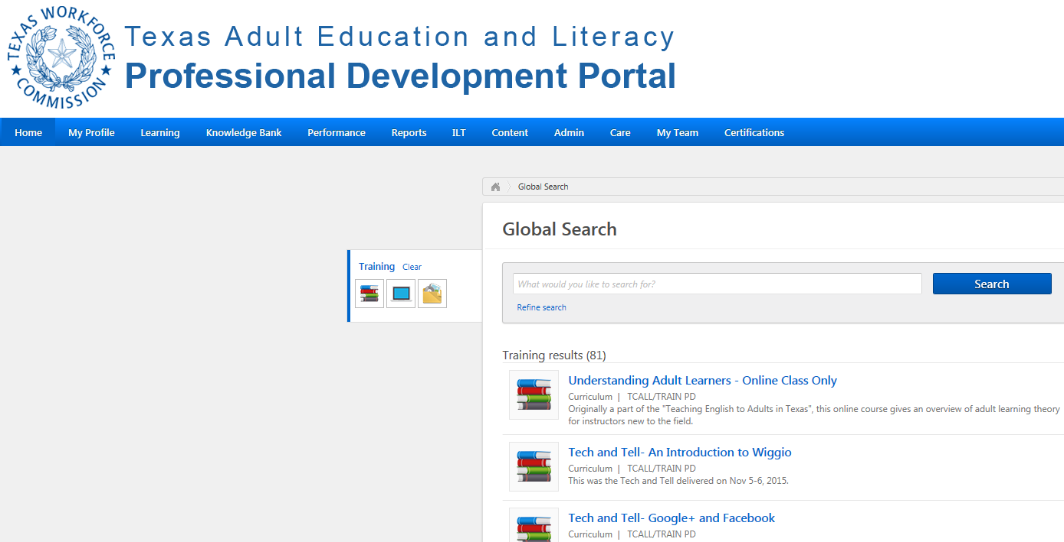
Learning Management System
Online Content
Calendar of PD events
Certificates of completion
Transcript of participation

Slide 15
TWC AEL Role
Investment in AEL grantees, PD Center and Capacity Building Projects
Project procurements
Project oversight
Program support and technical assistance

Slide 16
Capacity Building Projects
Sharply focused initiatives
Short-term
Support research and related resources
Support curriculum development
Expand educational technology
Accelerate integration of services with other educational organizations, including Workforce Boards.

Slide 17
2
TRAIN Tex
Training, Resource and Innovation Network for Texas
Texas Workforce Commission
Career Pathways Expansion
HCCS
PD & Program Integration Efforts with Non-Profits Literacy Texas OneStar Foundation
Public Library AEL Expansion Texas State Library and Archives Commission
Professional Development Center
Distance
Learning
Mentor Initiative
College of the Mainland
Northside ISD
Assessment & Standards Initiative
Texas State University
Focus on the Basics Reading & Math Institutes
Region 6 ESC
AEL Grantees & Literacy Providers

Slide 18
2
TRAIN Tex
Training, Resource and Innovation Network for Texas
Texas Workforce Commission
PD & Program Integration Efforts with Non-Profits Literacy Texas OneStar Foundation
Distance
Learning
Mentor Initiative
College of the Mainland
Northside ISD
Career Pathways Expansion
HCCS
Professional Development Center
Focus on the Basics Reading & Math Institutes
Region 6 ESC
Public Library AEL Expansion Texas State Library and Archives Commission
Assessment & Standards Initiative
Texas State University
AEL Grantees & Literacy Providers

Slide 19
2
TRAIN Tex
Training, Resource and Innovation Network for Texas
Texas Workforce Commission
Distance
Learning
Mentor Initiative
College of the Mainland
Northside ISD
Focus on the Basics Reading & Math Institutes
Region 6 ESC
PD & Program Integration Efforts with Non-Profits Literacy Texas OneStar Foundation
Professional Development Center
Assessment & Standards Initiative
Texas State University
Career Pathways Expansion
HCCS
Public Library AEL Expansion Texas State Library and Archives Commission
AEL Grantees & Literacy Providers

Slide 20
2
TRAIN Tex
Training, Resource and Innovation Network for Texas
Texas Workforce Commission
Focus on the Basics Reading & Math Institutes
Region 6 ESC
Assessment & Standards Initiative
Texas State University
Distance
Learning
Mentor Initiative
College of the Mainland
Northside ISD
Professional Development Center
Public Library AEL Expansion Texas State Library and Archives Commission
PD & Program Integration Efforts with Non-Profits Literacy Texas OneStar Foundation
Career Pathways Expansion
HCCS
AEL Grantees & Literacy Providers

Slide 21
2
TRAIN Tex
Training, Resource and Innovation Network for Texas
Texas Workforce Commission
Assessment & Standards Initiative
Texas State University
Public Library AEL Expansion Texas State Library and Archives Commission
Focus on the Basics Reading & Math Institutes
Region 6 ESC
Professional Development Center
Career Pathways Expansion
HCCS
Distance
Learning
Mentor Initiative
College of the Mainland
Northside ISD
PD & Program Integration Efforts with Non-Profits Literacy Texas OneStar Foundation
AEL Grantees & Literacy Providers

Slide 22
2
TRAIN Tex
Training, Resource and Innovation Network for Texas
Texas Workforce Commission
Public Library AEL Expansion Texas State Library and Archives Commission
Career Pathways Expansion
HCCS
Assessment & Standards Initiative
Texas State University
Professional Development Center
PD & Program Integration Efforts with Non-Profits Literacy Texas OneStar Foundation
Focus on the Basics Reading & Math Institutes
Region 6 ESC
Distance
Learning
Mentor Initiative
College of the Mainland
Northside ISD
AEL Grantees & Literacy Providers

Slide 23
2
TRAIN Tex
Training, Resource and Innovation Network for Texas
Texas Workforce Commission
Career Pathways Expansion
HCCS
PD & Program Integration Efforts with Non-Profits Literacy Texas OneStar Foundation
Public Library AEL Expansion Texas State Library and Archives Commission
Professional Development Center
Distance
Learning
Mentor Initiative
College of the Mainland
Northside ISD
Assessment & Standards Initiative
Texas State University
Focus on the Basics Reading & Math Institutes
Region 6 ESC
AEL Grantees & Literacy Providers

Slide 24
ACTIVITY – How does TRAIN Tex work?
Each of you has a card with a TRAIN Tex component
Gather by the poster board that matches your card
Consult with expert for that content area
Determine who you will need to coordinate with to complete your projects
Share comments and observations

