Slide 1
Open Educational Resources: Teachers are Experts!
Amanda Duffy
Senior Researcher
Adult Learning Practice Area
Month 20XX
Copyright © 20XX American Institutes for Research. All rights reserved.
XXXX_MM/YY

Slide 2
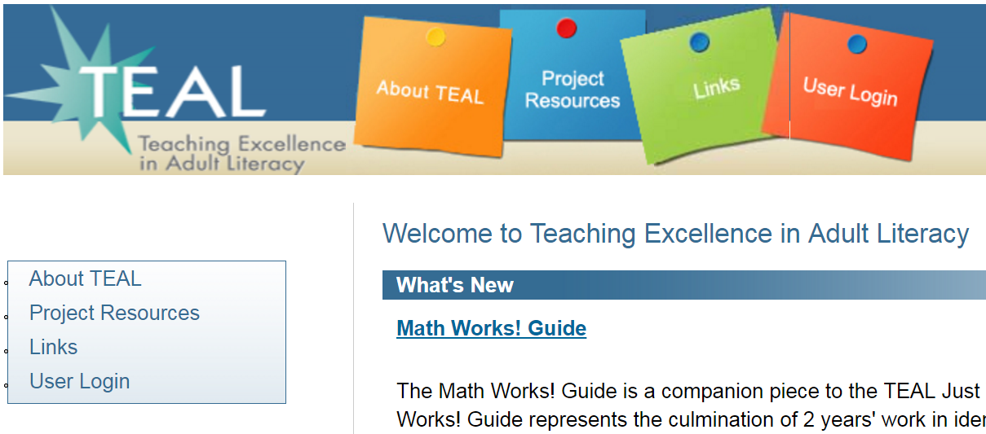
American Institutes for Research
Notes:
Established in 1946, with headquarters in Washington, D.C., American Institutes for Research (AIR) is an independent, nonpartisan, not-for-profit organization that conducts behavioral and social science research and delivers technical assistance both domestically and internationally.
As one of the largest behavioral and social science research organizations in the world, AIR is committed to empowering communities and institutions with innovative solutions to the most critical challenges in education, health, workforce, and international development.
Briefly review the Adult Learning Projects identified on the screen

Slide 3
Session Objectives
Participants will be able to
Define OER
Articulate the value of OER in adult education
Follow the steps to create OER in a free online tool (Open Author)
Image source: UDL Center
Notes:
Session Description Submitted:
The National Education Technology Plan and the College and Career Readiness Standards present the field with a new way to think about requirements for student success and meeting the ever-changing demands of the workforce and education systems. In this interactive session, participants will work together to combine expertise with cutting edge technology that supports them to meet the need for new types of learning materials and instructional approaches. This can be achieved through open educational resources (OER). OER are free, adaptable, and sharable materials that can be created to develop student centered materials for the classroom, distance learning, and flipped classrooms. OER are significant for adult English language educators because they are free and sharable, able to be remixed and revised to meet learner needs, and customizable. Participants will do hands-on activities to: determine if a resource is open, integrate OER into instruction, and create and share OER. By creating OER teachers can increase student engagement while preparing them to be life-long learners and increase their 21st century skills. Through a project funded by the office of Career, Technical, and Adult Education (OCTAE), two groups of Adult ESL Teachers engaged in all of these activities. Their successes and challenges will be used to demonstrate real world application. Participants are encouraged to bring laptops to fully engage in the learning experience.

Slide 4
Who is here?
Notes:
Have participants do a quick turn and talk
Who they are
Where they teach
What they teach
Then…
By show of hands –
Who teaches ESL? ABE? Career Pathways? Transitions? Civics?
Other?

Slide 5
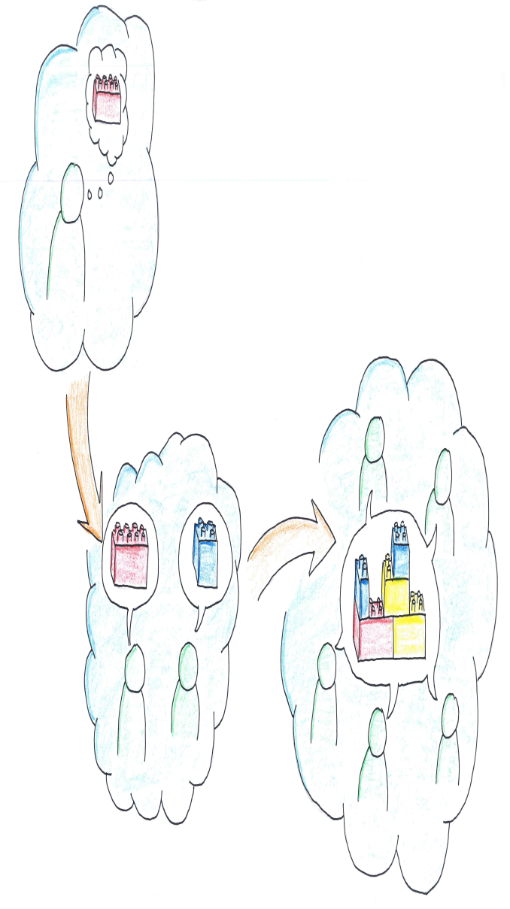
Think Pair Share
Think of a lesson, activity or resource that you created to solve a problem or meet a specific need
Pair with a partner and discuss the following
What was the problem or need?
What did you create to solve the problem or meet the need?
Did you share your solution with others? How did you share it?
Share with the group
Oliver Tack, Think Pair Share, Flicker, CC BY
Notes:
Person Responsible:
Time: 10 min
Materials Needed:
Notes:
Possible Guiding Questions:
Chart Responses to the following:
Ask each person to think of a lesson, activity or resource that they created to solve a problem and have a think-pair-share activity. Then, discuss responses to prompts on the screen in pairs. We will ask for volunteers to share out. Explain that we will explore OER as a solution to sharing/finding resources throughout the session, focusing on teachers as expert creators. In order to do this successfully, we first have to review the value and definition of OER.

Slide 6
Why OER?
Notes:
Person Responsible:
Time: 1 min
Materials Needed:
Notes:
Possible Guiding Questions:

Slide 7
A big challenge we face
The ongoing need to adapt our teaching to
Stay relevant to students’ lives
Address College and Career Readiness Standards
Integrate new skills such as digital literacy
The need to share ideas with colleagues and learn from others
Notes:
Person Responsible:
Time: 3-5 min
Materials Needed:
Notes:
Possible Guiding Questions:
…“Colleagues around the world are creating resources to address some of the same challenges that we face. But it has proven difficult to find ways to find and share these things with each other. The Internet is making it easier for us to share the resources that we make and to use the resources that others want to share.”

Slide 8
The Value of OER
Open educational resources create efficient and affordable options for teachers and learners
Adult educators and learners benefit from participation in an open community
OER permissions (free and legal) allow for continuous evolution of practice and materials
Notes:
Person Responsible:
Time: 3 min
Materials Needed:
Notes:
Possible Guiding Questions:
Education is a matter of sharing and the open educational resources approach is designed specifically to enable efficient and affordable sharing.
Open educational resources also allow the full power of the Internet to be brought to bear on education.--by allowing a seamless sharing of educational resources with other people around the world. This is commonly called an open community—the world community in which educators, learners, and others can share materials, resources, and ideas.
OER provide teachers with free and legal permissions to engage in continuous quality improvement processes like incremental adaptation and revision, enabling teachers and learners (anyone in the open community) to fully control or manage their materials, courses and textbooks in a manner not previously possible
Other points to note
OER help meet the demand for high quality content in adult education, while enhancing instructional practice and student learning.
OER help students achieve their learning goals by providing flexible and accessible supplements to instruction.
OER encourage life-long learning habits in students and they also help educators do their job better by augmenting instruction and helping teachers learn about new topics.

Slide 9
What are Open Educational Resources?
Notes:
Person Responsible:
Time: ~1 min
Materials Needed:
Notes:
Possible Guiding Questions:

Slide 10
What are OER?
“Open educational resources (OER) are teaching, learning, and research resources that reside in the public domain or have been released under an intellectual property license that permits sharing, accessing, repurposing—including for commercial purposes—and collaborating with others.”
~ Office of Educational Technology, National Educational Technology Plan, page 56
Notes:
Person Responsible:
Time: 3-5 min
Materials Needed:
Notes:
Possible Guiding Questions:
According to the National Educational Technology Plan, Open Education Resources are objects that
supports or facilitates teaching learning and research;
It lives in the public domain
It has been released under an intellectual property license (this is most commonly referred to as a Creative Commons license, but there are other names for it) and we’ll explore CC in greater depth in a few minutes)
And that license allows for sharing, accessing and repurposing
Please raise your hand if you have ever heard of the 5rs in relation to OER.

Slide 11
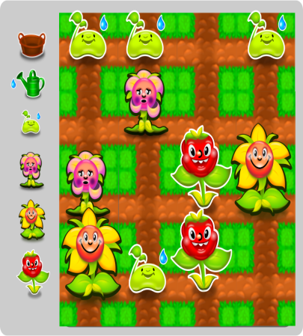
Examples of OER
Podcasts & audio files
Lesson Plan:
Laws of
Inertia
Simulations
Textbooks
Music
Apps
Games
Notes:
Person Responsible:
Time: 1 min
Materials Needed:
Notes:
Possible Guiding Questions:
OERs cover a wide range of tools that you can incorporate into your instructional and assessment activities.
Podcasts
Games/simulations
Lesson plans
Apps
Digital textbooks
Digital courses/curriculum
Digital libraries
***REMEMBER THAT YOU MUST CHECK THE CREATIVE COMMONS/TERMS OF USE TO DETERMINE IF AN OBJECT IS TRULY AN OER***** I.e. all podcasts are not OERs…all online lesson plans are not OERs, etc.
All images are Public Domain and retrieved from openclipart.org; exceptions: Simulations is CC BY from Idaho National Library (Https://www.flickr.com/photos/inl/
Apps is CC BY from Christopher Vizcarra https://www.flickr.com/photos/89112732@N04/

Slide 12
OER Example
http://www.oercommons.org/courses/adult-literacy-fundamentals-mathematics-book-5/view
Notes:
Person Responsible:
Time: 1-2 min
Materials Needed:
Notes:
Possible Guiding Questions:
If the internet is working well, we can open this link and show the live version and show the wealth of OER embedded within this one resource: http://www.oercommons.org/courses/betsy-s-eclection-language-technology/view
If not, we can verbally explain what’s on this site.

Slide 13
OER Example #2
https://www.oercommons.org/authoring/6650-fahrenheit-to-celcius-conversions-for-the-adult-es/view
Notes:
Person Responsible:
Time: 1-2 min
Materials Needed:
Notes:
Possible Guiding Questions:
If the internet is working well, we can open this link and show the live version: https://www.oercommons.org/authoring/7994-parts-of-the-body-an-esl-lesson-plan-for-adult-lit/view
If not, we can verbally explain what’s included in this lesson.

Slide 14
The 5Rs of OER
Reuse:
the right to reuse content
Redistribute:
the right to share content
Remix:
the right to combine content to make something new
Retain:
the right to make, own, and control copies of the content
Revise:
the right to modify content
Creative Commons
Notes:
Person Responsible:
Time: 4 min
Materials Needed:
Notes:
Possible Guiding Questions:
Another way to help you determine if an object is an OER is by using the 5Rs – these were identified and made popular by David Wiley who is a leader in the open education movement. The 5 Rs provide an easy way to check if an object meets the criteria needed to be considered an open educational resource.
The first R is Reuse – This is the right to reuse the content in its unaltered / verbatim form (e.g., make a digital copy of the content)
2. The next R is Redistribute – This is the right to share copies of the original content, your revisions, or your remixes with others (e.g., Are you allowed to give a copy of the content to a colleague or make copies for your students)
3.Remix - the right to combine the original or revised content with other content to create something new (e.g., you found a lesson plan online that you want to use, but you want to incorporate some technology aspect into it. You find an interactive online learning tool that supports your objective so you combine the two and create a New object. You’ve just remixed two items!
4.Revise - the right to adapt, adjust, modify, or alter the content itself (e.g., you modify the language of a text to match your students’ reading levels, or you alter the assessment activities so they provide deeper learning experiences for your students.)
5. Retain – as the original creator you will always retain the right to your resource. If others modify it and share it, your original version will still exist as you created it with your license.
As you search for OER to use in your classrooms, you want to make sure that a learning resource is in fact open. Most objects state the terms of use on the page, but you may have to dig a bit to find out what you are allowed to do – in a few minutes, we’ll show you some tips for digging a bit deeper. One of those tips is on your screen – creative commons.

Slide 15
Open Educational Resources
Supporting many instructional and learning goals
Notes:
Person Responsible:
Time: ~1 min
Materials Needed:
Notes:
Possible Guiding Questions:

Slide 16
Ways OER can be incorporated
Blended Learning/ Flipped Classroom
OER
Students as Creators
Images & Videos
Professional Development
Lesson Plans
Differentiate Instruction
Extra Practice Exercises
Notes:
Person Responsible:
Time: 2 min
Materials Needed:
Notes: Slide is animated so we can ask participants what they think first
Possible Guiding Questions:
Show examples (screenshots included in following slides): https://www.oercommons.org/authoring/6937-cause-and-effect-in-reading-passages (lesson plan)
http://www.oercommons.org/courses/smartphones-in-adult-esl-instruction-picture-prompts-and-review/view (professional development video)
https://nsdl.oercommons.org/courses/ramp-up-your-writing (interactive, web based tool;differentiation)

Slide 17
OER Lesson Plan Example
https://www.oercommons.org/authoring/6937-cause-and-effect-in-reading-passages/view
Notes:
Person Responsible:
Time: 1 min
Materials Needed:
Notes:
Possible Guiding Questions:

Slide 18
OER Professional Development/Video Example
http://www.oercommons.org/courses/smartphones-in-adult-esl-instruction-picture-prompts-and-review/view
Notes:
Person Responsible:
Time: 1 min
Materials Needed:
Notes:
Possible Guiding Questions:

Slide 19
OER Interactive Web-based Differentiation Example
https://nsdl.oercommons.org/courses/ramp-up-your-writing
Notes:
Person Responsible:
Time: 1 min
Materials Needed:
Notes:
Possible Guiding Questions:

Slide 20
Creating and Sharing OER
Notes:
Person Responsible:
Time: ~1 min
Materials Needed:
Notes:
Possible Guiding Questions:
Insert some questions about what materials teachers use to create lessons, where they store their lessons, if they share, etc…Insert questions about the value of creating and sharing open resources, specifically in the context of adult esl

Slide 21
Open Author on OER Commons
Open Author provides a place where educators can build and share high-quality open educational resources (OER), such as courses, units, lessons, activities and presentations, to meet teaching and learning needs around the globe.
Notes:
Person Responsible:
Time: 2 min
Materials Needed:
Notes:
Possible Guiding Questions:
Open Author provides a place where educators can build and share high-quality open educational resources (OER), such as courses, units, lessons, activities and presentations, to meet teaching and learning needs around the globe.
Similar to Microsoft Word
You can search for Open Author resources in OER Commons with the Open Author resources filter on the Advanced Search page.
All related media files may be exported using the ‘download teaching bundle’ feature
You may upload videos, images, documents, slide presentations, and audio files into Open Author.
Need an OER Commons account to create

Slide 22
Open Author
Write
Describe
Submit
Notes:
Person Responsible:
Time: 1-2 min
Materials Needed:
Notes:
Possible Guiding Questions:

Slide 23
Step 1: Write (Create)
Notes:
Person Responsible:
Time: 3 min
Materials Needed:
Notes:
Possible Guiding Questions:

Slide 24
Step 1: Completed Example
https://www.oercommons.org/authoring/7849/preview
Notes:
Person Responsible:
Time: 1 min
Materials Needed:
Notes:
Possible Guiding Questions:

Slide 25
Step 2: Describe
Notes:
Person Responsible:
Time: 3 min
Materials Needed:
Notes:
Possible Guiding Questions:
Abstract
Subject
Primary User
Educational Use
Level (can add adult ed!)
Material Type
Learning Goals
Keywords (add adult ed!)
Align to CCRS is applicable

Slide 26
Step 2: Completed Example
Notes:
Person Responsible:
Time: 1 min
Materials Needed:
Notes:
Possible Guiding Questions:

Slide 27
Step 3a: Select License
Notes:
Person Responsible:
Time: 2 min
Materials Needed:
Notes:
Possible Guiding Questions:

Slide 28
Step 3a: Completed Example
Notes:
Person Responsible:
Time: 1 min
Materials Needed:
Notes:
Possible Guiding Questions:

Slide 29
Step 3b: Share!
Notes:
Person Responsible:
Time: 1 min
Materials Needed:
Notes:
Possible Guiding Questions:

Slide 30
Step 3b: Completed Example
Notes:
Person Responsible:
Time: 1 min
Materials Needed:
Notes:
Possible Guiding Questions:

Slide 32
Wrap Up & Reflections

Slide 33
Reflections
What is something you want to know more about?
What is one thing you plan on doing differently because this workshop?
Notes:
Person Responsible:
Time: 10 min
Materials Needed:
Notes:
Possible Guiding Questions:

Slide 34
Education is inherently an enterprise of openness and sharing and generosity.
- David Wiley

Slide 35
Where to Find OER
College and Career Readiness:
Achieve the Core http://achievethecore.org/
EngageNY https://www.engageny.org/
All Subjects
OER Commons https://www.oercommons.org/
Learn NC http://www.learnnc.org/learning
Adult Education Computer Curriculum
Saint Paul Community Literacy Consortium http://spclc.org/curricula-resources/computer-curriculum
Digital Literacy
Digital Learn http://digitallearn.org/
Open Textbooks and Courses
Open Course Library http://opencourselibrary.org/
OE Consortium http://www.oeconsortium.org/

Slide 36
Other Resources
Open Author to Create OER
https://www.oercommons.org/open-author-about
Creative Commons to Learn about Licenses
https://creativecommons.org/licenses/
CCSearch to find open images
https://search.creativecommons.org/

